Slide 1
A Review of Critical Flow Venturis

Slide 2
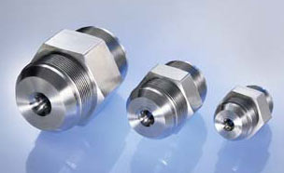
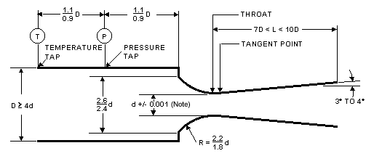
Sonic Nozzles

Slide 3
Discharge Coefficient C_{d}

Slide 4
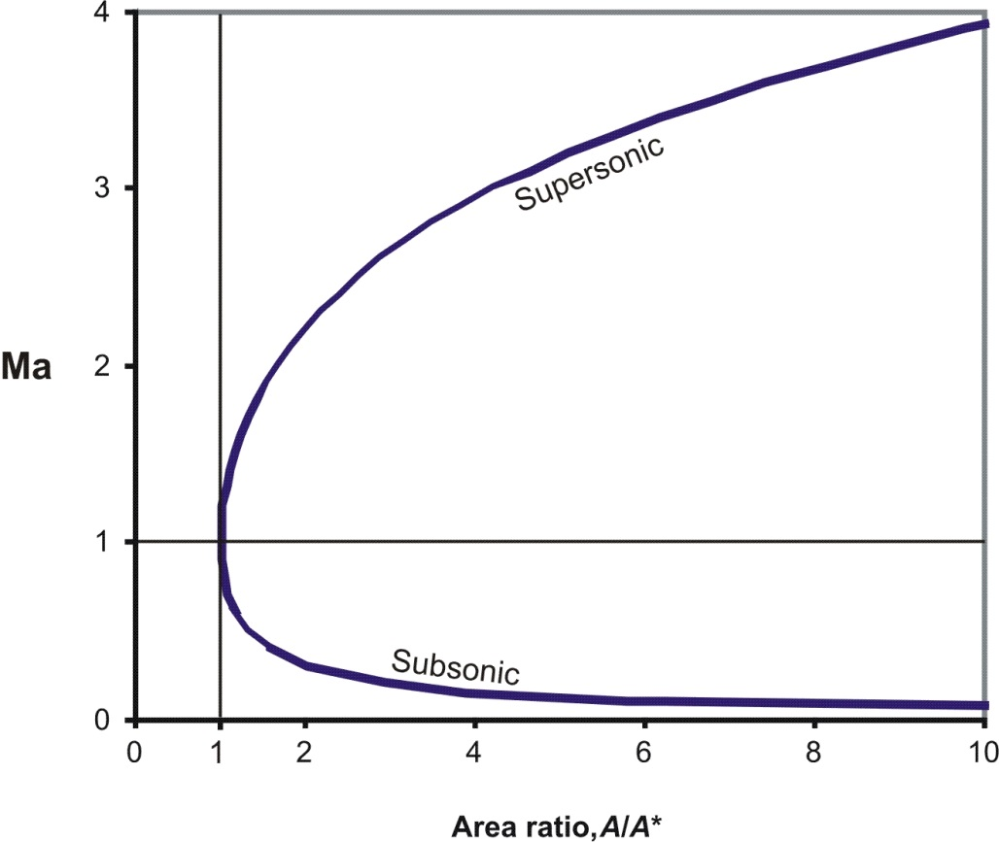
Isentropic, 1-Dimensional Flow, Perfect Gas
Velocity at each cross section of a convergent-divergent critical venturi (Reynolds 1886, Rayleigh 1916)

Slide 5
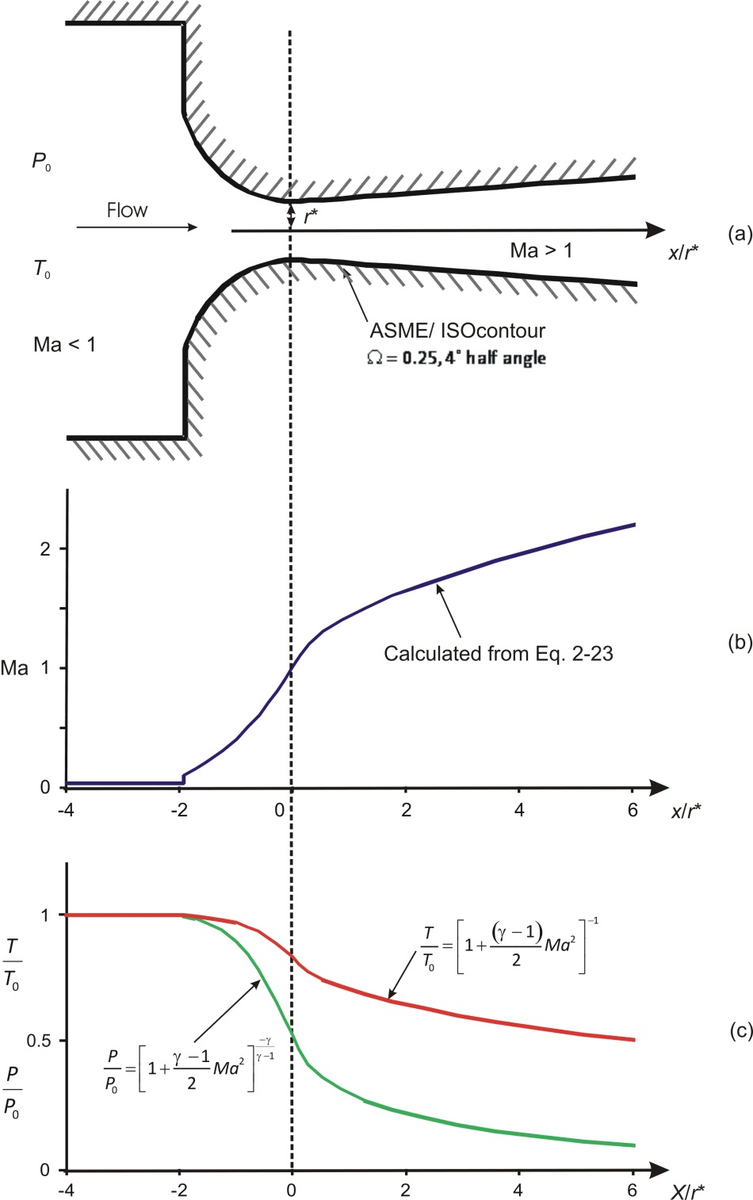
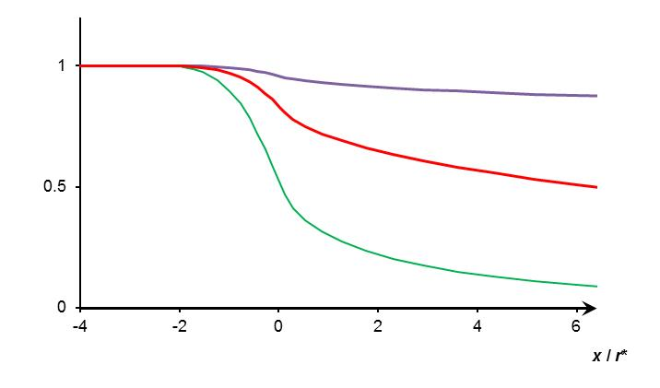
Isentropic, 1-Dimensional Flow, Perfect Gas, Fully Expanded (no shocks)

Slide 6
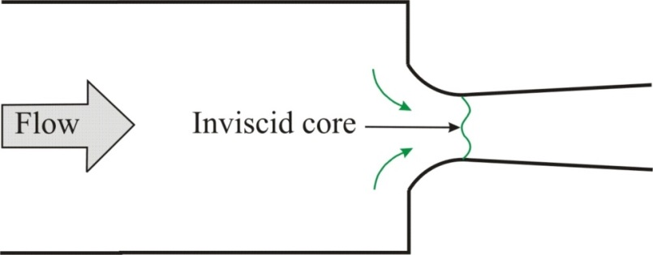
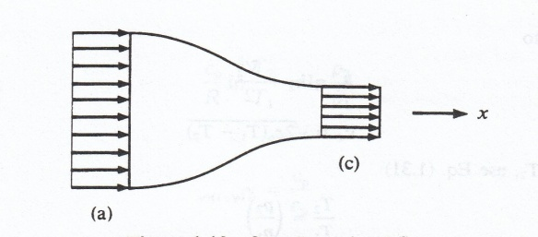
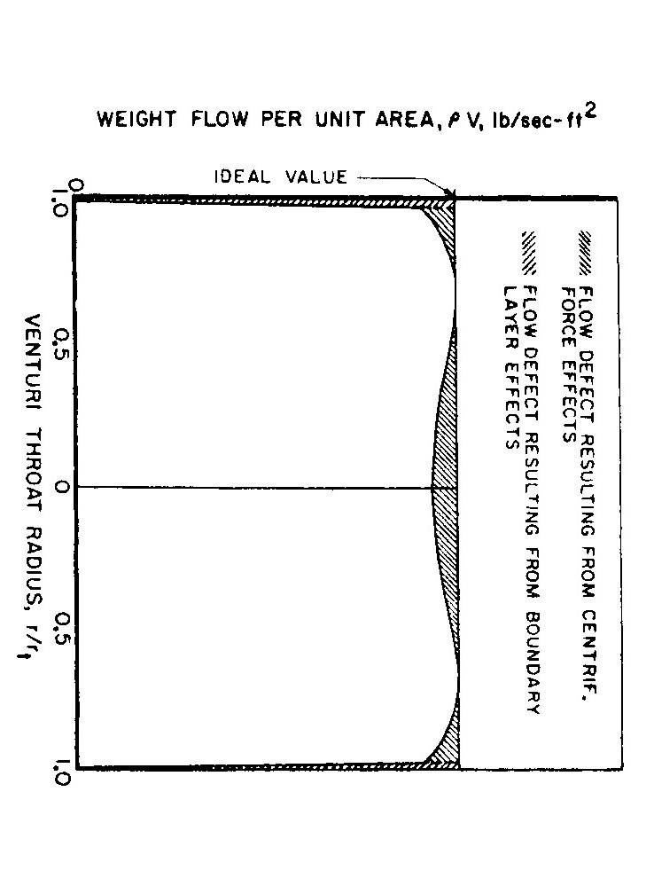
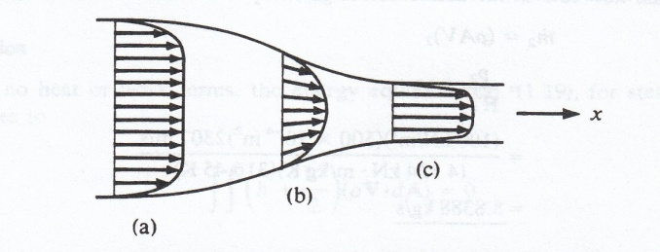
Inviscid Core Flow
Smith and Matz 1962, “A non-one-dimensional flow exists because of the centrifugal forces created by the turning of the flow in the contraction section.”
1-D:
2-D:
Hall 1962, Kliegel and Levine 1969 → 0.12 %
where α₂, α₃, and α₄ are gas species dependent components and Λ is the expansion parameter (R or 1 + R).

Slide 7
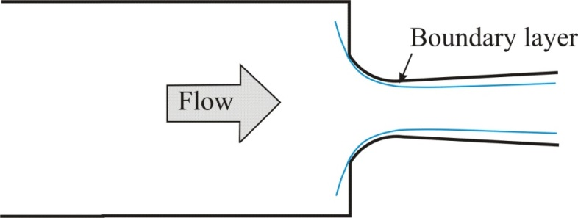
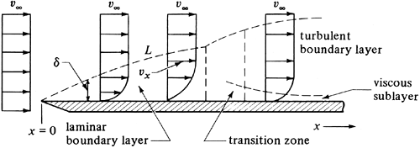
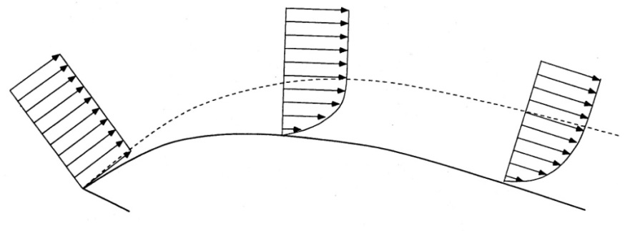
Velocity Boundary Layer: C_{d} scales with Re^{-1/2}
Blasius: boundary layer on a flat plate
Laminar: Tang 1969, Geropp 1971, similarity transformations
Turbulent: Stratford 1964, integral boundary layer technique
Mickan 2006
Transition at Re $≅$ 1 x 10⁶
where Ω = r*/R is the throat curvature ratio (nominally 0.25 for an ASME / ISO venturi), a₁ and a₂ are coefficients, and m and n are exponents whose values depend on whether the flow is laminar or turbulent.

Slide 8
Reynolds Number Scaling

Slide 9
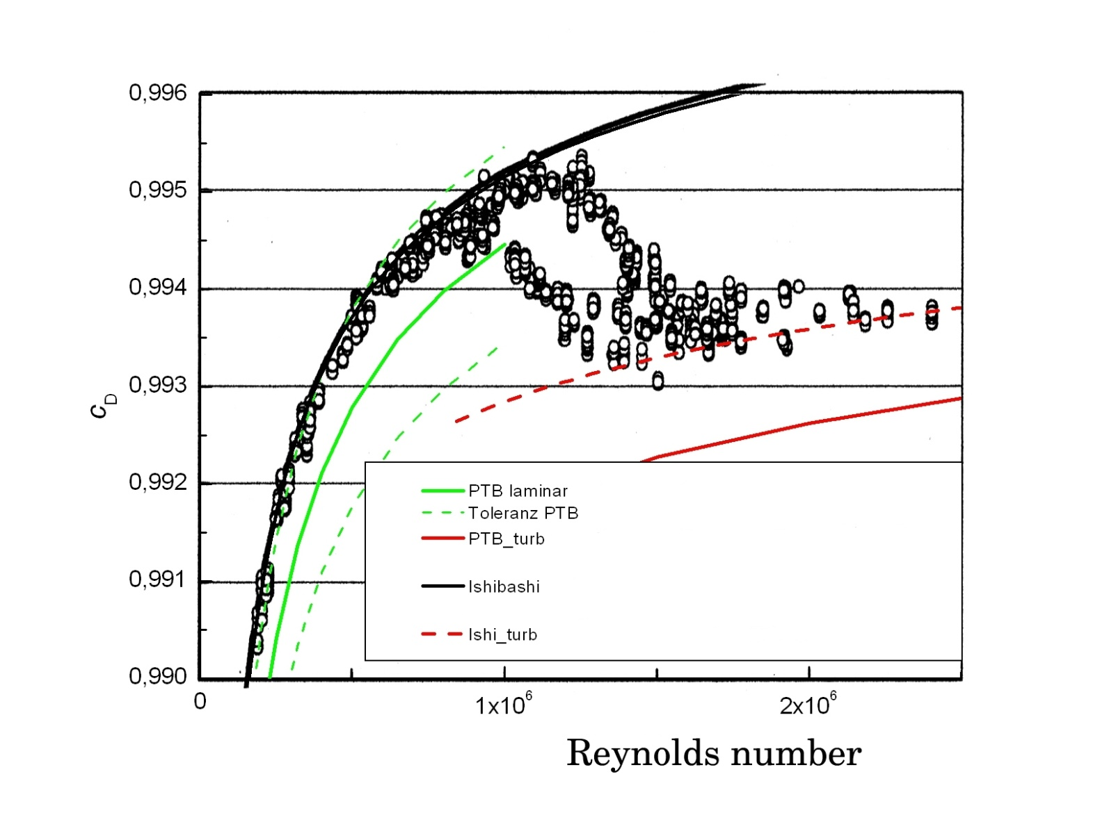
Boundary Layer Transition
Ishibashi and Arnberg, The Effect of Inlet Geometry on the Critical Flowrate of Toroidal Throat Venturi Nozzle, CFVN Workshop, Quedlinburg, Germany, June, 2005

Slide 10
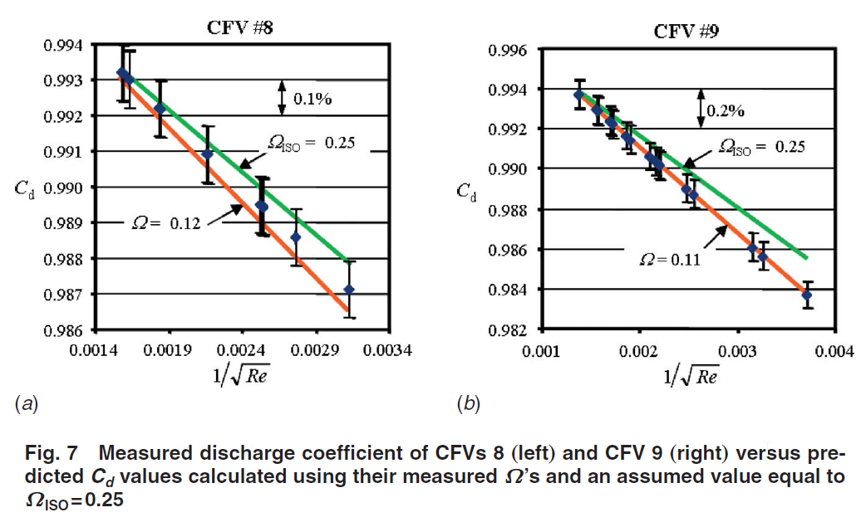
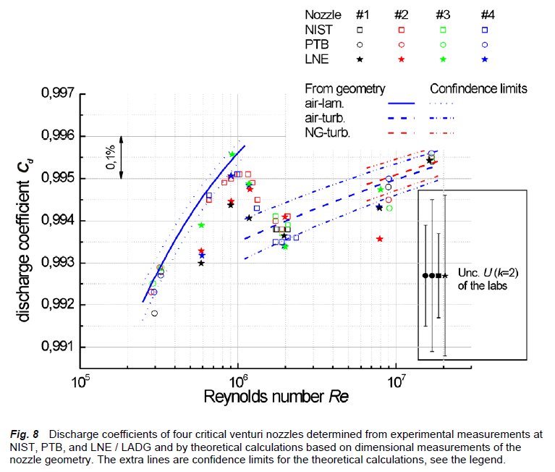
Analytical C_{d} predictions agree well with experiments
Johnson and Wright 2008
Mickan 2006

Slide 11
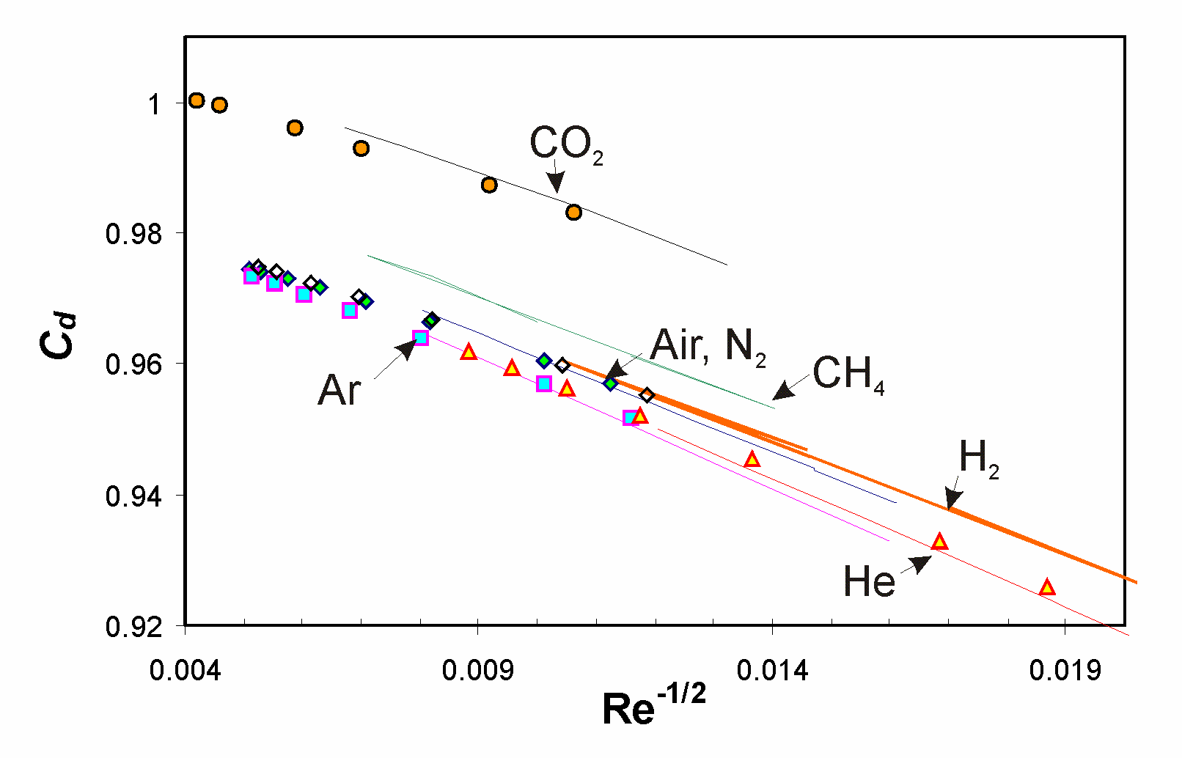
Gas Species Effects
Solid lines from Nakao and Takamoto, Discharge Coefficients of Critical Flow Venturi Nozzles for CO₂ and SF₆, Transactions of the ASME, December, 2000, d = 0.295 to 2.36 mm.
Points from NIST experiments, d = 0.387 mm.

Slide 12
C_{d} can be treated as numerous uncoupled physical phenomena
C_{d} = C_{R}*C_{inv} C_{vbl} C_{Tbl} C_{α} C_{vib} + higher order terms
Inviscid core flow
Real gas effects
Velocity boundary layer
Thermal boundary layer
Vibrational relaxation (CO₂, SF₆)
Thermal expansion of CFV material

