Slide 1


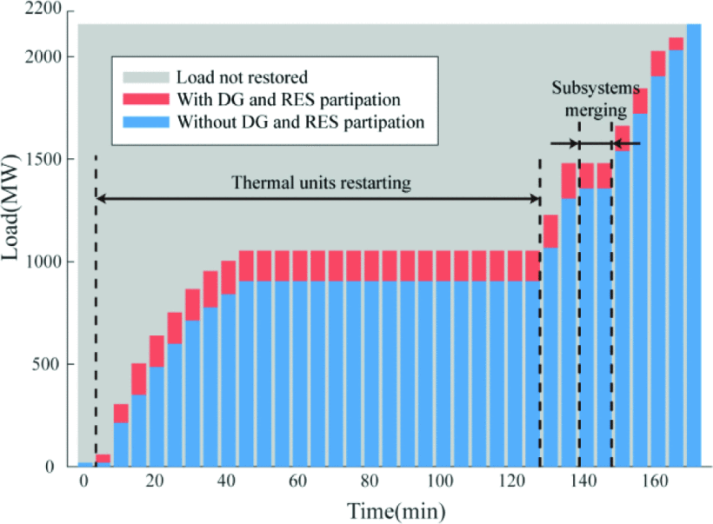
Masterarbeit
Fachgebiet für Elektrische Energiesysteme (EES)
A fast restoration algorithm for medium voltage distribution networks after blackout with renewable energy integration
Blackouts in distribution systems disrupt electricity supply and can take significant time to recover. With the increasing integration of renewable energy sources (RES), there is growing potential to leverage these assets during post-blackout restoration. However, many current restoration strategies do not effectively consider the dynamic availability of RES or apply real-time optimization for decision-making.
This thesis aims to extend an existing restoration algorithm framework tailored for post-blackout scenarios in MV distribution networks, and integrate forecast-based availability of RES into the restoration logic. The algorithm shall identify and incorporate additional operational and restoration constraints and assess the availability of RES to enhance system recovery. The preferred programming environment can be either Python or DIgSILENT Programming Language (DPL) whereas the modelling and simulation of the medium voltage distribution network would be carried out in DIgSILENT PowerFactory. The proposed approach would be validated in terms of feasibility and robustness through different case studies and simulation scenarios and then evaluated against existing approaches in literature.
Reference:
J. Pang, L. Shi und Y. Ni, "A Multi-agent Based Control Framework for Coupled Transmission and Distribution System Restoration Containing Wind Power and Energy Storage," in 2019, S. 2324–2329, doi: 10.1109/iSPEC48194.2019.8975119.
Betreuer und Ansprechpartner
Yasir Shamim
yasir.shamim@uni-due.de
BA 060
Bearbeiter
Mehrdad Karimi Raoof

