Slide 1
Dance with the Trump Administration: The Roles of U.S. Congress in Sino-US Decoupling
Dr. Baogang Guo
Dalton State college

Slide 2
Institutionalist Analyses of the Roles of the U.S. Congress
U.S. Congress is usually not in the driver seat when it comes to making foreign policies. However studies show Congress can influence the policy outcomes in an important way by changing the structure and procedures of decision-making in the executive branch.
In this study, we will follow the new institutionalist approach and provide three basic analyses of the emerging congressional activism on China-related legislation and the roles of institutional and procedural changes played in the rapid deuteriation of the Sino-US relations since the start of the Trump Administration.
A historical analysis of legislative data to illustrate the progression in congressional activism in China-related legislation.
A political analysis of the role of Congress-created new institutions and procedures on U.S.-China relations.
A content analysis of major pieces of China-related legislation introduced in the 116th session of U.S. Congress.

Slide 3
A Historical Analysis
In recent decades only about 1% or less of bill introduced in Congress has something to do with China. It is obvious there is a big spike in the 115th and 116th sessions of Congress. There are 24,349 pieces of House or Senate bills proposed as of September 26, 2020 since 2016, 589 were China-related. That’s 2% of the total or a 100% increase. The 116th Congress see an even more China-related bills. The total number of bills introduced is 13,143 (as of Sept. 26, 2020). There are 414 China-related bills, which makes it 3% of the total. This is the record high according to Chart 1.
Chart 1: Total China-related Bills Introduced in Congress
Source: congress.gov, accessed Sept. 6, 2020.

Slide 4
A Historical Analysis
Chart 2 China-related House or Senate Resolutions and Sentiments
Chart 2 shows a steady increase in the number of House and Senate resolution proposals pertaining to China. However, a significant number of cases in the data set presented by the website touch on China only in a very indirect way or simply contains the word China. A further analysis of the sentiments expressed by these proposed resolutions indicates that the number of negative resolutions consistently overweights the positive ones, especially in the 115th and 116th Congress.
Source: congress.gov, accessed Sept 6, 2020

Slide 5
A Historical Analysis
Chart 4 China-related Bills That Become Public Laws
As a reaction to recent events, 535 pieces of legislation (as of September 6, 2020) were introduced in Congress since 2019, and six major pieces of bills were passed by both houses of Congress and signed into law by President Trump. Given the fact that only 15 pieces of bills were introduced in the 116th Congress, the passage rate was 40%.
Source; congress.gov, accessed Sept. 6, 2020

Slide 6
A Historical Analysis
Charter 5: Tibet, Taiwan, and Xinjiang Related Legislative Proposals
Between the 94th and the 116th sessions of Congress, there are 951 pieces of Taiwan-related legislative proposals, 374 are Tibet-related, and 71 are Xinjiang-related. The total bills proposed for the three regions exceeds 1,396 pieces, which is about half of all legislative bills proposed that are related to China
Source: congress.gov, accessed Sept 6, 2020

Slide 7
A Political Analysis
There are several important new institutions and institutional procedures Congress created in recent decades. They have played an important role in setting legislative and executive agenda. These include:
Congressional-Executive Commission on China (CECC)
The US-China Economic and Security Review Commission (USCC)
House Republican China Task Force (CTS)
The Bipartisan U.S.-China Working Group (USCWG). Many of the members of these entitles have played a pivotal role.

Slide 8
US-China Relation Act of 2000
In 2000 Congress passed an important piece of legislation US-China Relation Act of 2000 and President Clinton signed it into law (P.L. 106-286). The law granted China the permanent most favored nation trade status (Division A). It also laid out a structural framework in dealing with US-China relations (Division B).
The CECC was created as a condition for congressional approval of permanent normal trade relations with China. It is designed to continue the debate on human rights issues in China.
The law also asked the US Office of Trade Representative to submit to Congress by December each year a report on China’s compliance with commitments made in connections to the WTO.
A Task Force on Prohibition of Importation of Products of Forced or Prison Labor from China is established. Itis obligated to submit its annual report to Congress.
The three annual reports from the CECC, the USTR, and the Task Force on Products of Forced Labor constitutes as the basis of annual US review of US-China relations.

Slide 9
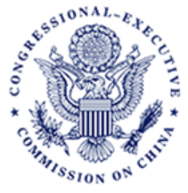
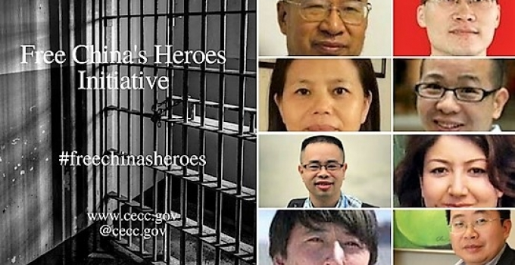
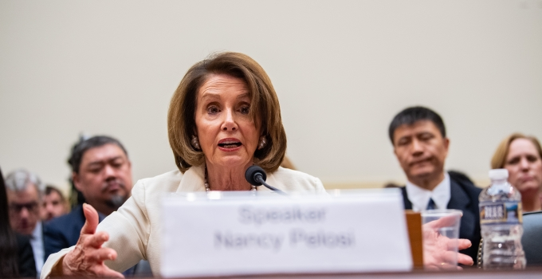
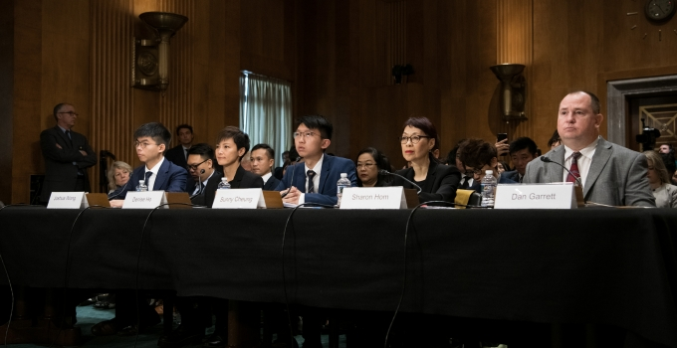
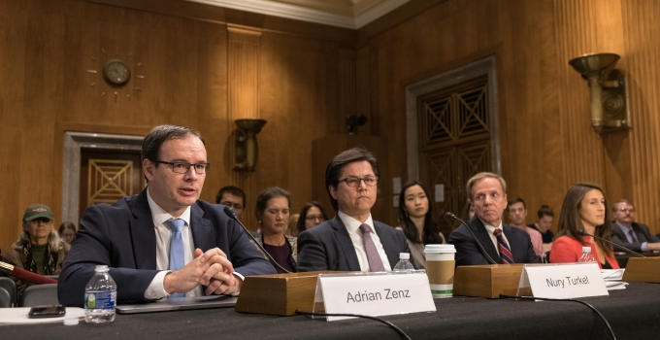
THE CECC
The CECC normally hold four hearings on China each year, and occasional roundtable discussions. Its publication includes Commission Analysis, Issue Papers, and Annual Report to Congress. They become the key sources of information or misinformation on China for many Congresspersons and Senators.
The Commission consists of 9 Senators a9 House Members, and 5 senior Administration Officials.

Slide 10
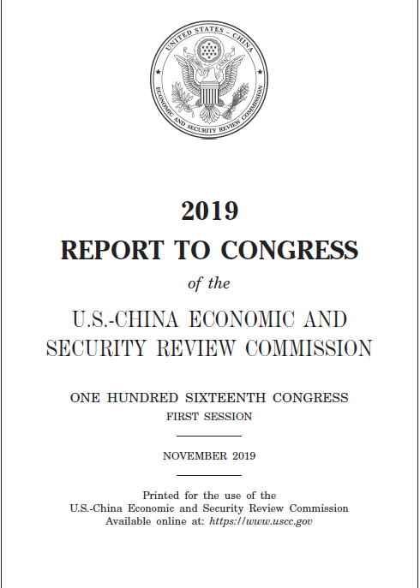
THE USCC
The National Defense Authorization Act of 2001 (P.L. 106-398) established U.S-China Economic and Security Review Commission (USCC). The purpose of the Commission is to monitor, investigate, and report to Congress on the national security implications of the bilateral trade and economic relationship between the United States and the People’s Republic of China. It must report to Congress annually.
The commission has 12 commissioners. They are all from private sectors and are appointed by congressional leaders. In 2019, the Commission held eight public hearings.
Its publication includes annual report to Congress and Issue Briefings.

Slide 11
House Republican China Task Force (CTF)
For more than a year, top leaders from both parties in the House of Representatives worked to form a bipartisan committee to oversee congressional strategy on China. But in February, the Democrats walked away on the project.
The House Republicans created its “China Task Force” in May 2020. It is a committee of 15 Republican lawmakers representing 11 different committees of jurisdiction, to coordinate legislative strategy on all aspects of the China challenge. The Members were assigned to six pillars to address the various aspects of the China Challenge: Ideological Competition, Supply Chain Security, National Security, Technology, Economics & Energy, and Competitiveness. The CTF drafted its first report by September, 200, which contains 82 key findings and more than 400 recommendations, most of which have already been implemented by the Trump Administration.

Slide 12
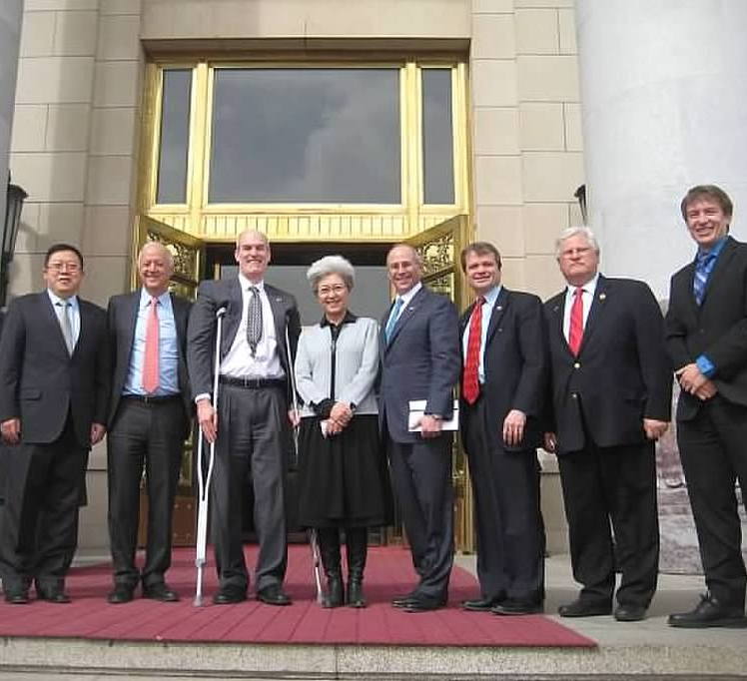
THE USCWG
The only group in the U.S House of Representatives that designed to lay the US-China relations on a rational and practice basis is the Bipartisan U.S.-China Working Group (USCWG), chaired by Congressmen Rick Larsen (WA-2) and Darin LaHood (IL-18), was founded in 2005.
The U.S.-China Working Group seeks to build diplomatic relations with China and educate Members of Congress through meetings and briefings with business, academic and political leaders from the U.S. and China. It has sent nine Congressional delegation to Beijing to facilitate dialogs between the two countries.
This group is less formal and influential than the CECC and USCC.

Slide 13
A Content Analysis of Key Legislation in the 116th Congress
According to the co-chair of USWG, Congressmen Rik Larsen (D, WA),
“In Congress there are national security hawks on China, trade hawks on China, and human rights hawks on China. So long as they didn’t talk to each other, they didn’t realize they all hated China…In the last few years those three groups have found each other and have created a different consensus in Congress, and on where that center of gravity sits.”

Slide 14
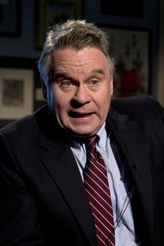
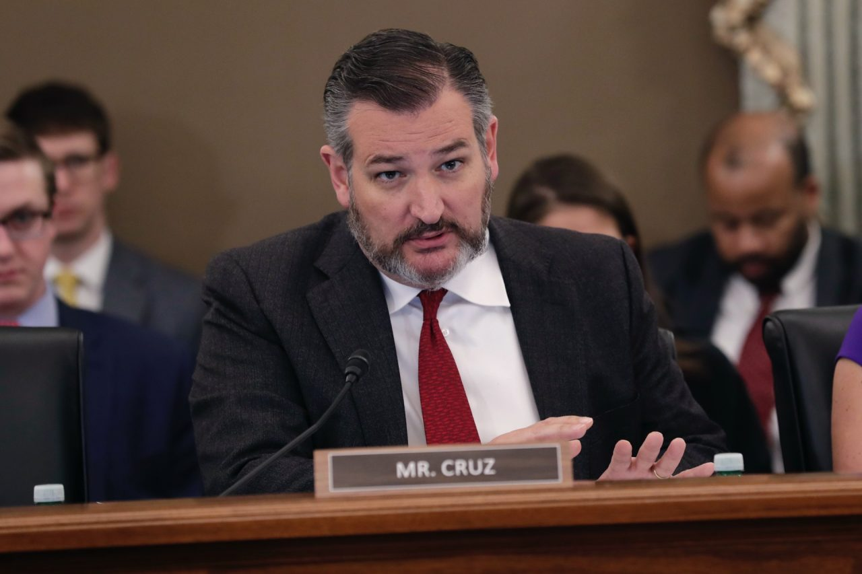
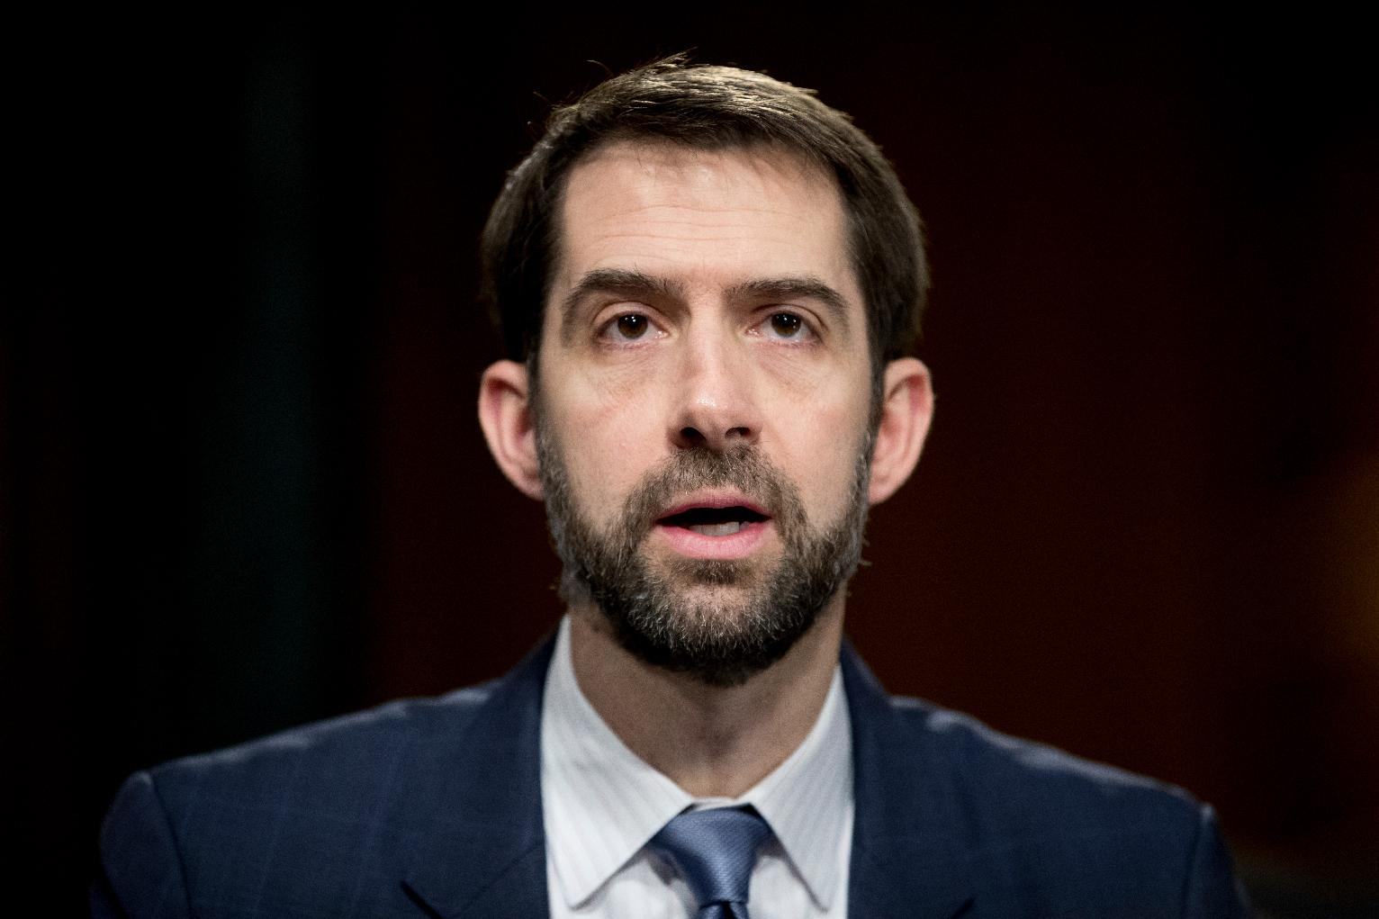
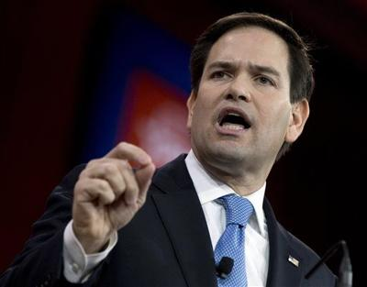
The China Hawks
A few leaders as well as members of these new institutions, such as Marco Rubio, Ted Cruz, Christopher Smith, and Tom Cotton have played a major role in pushing the anti-China legislation. They were behind many of the latest anti-China legislation.
Both Senator Marco Rubio and Ted Cruz were of Cuban decent. Rubio was strongly influenced by Cuban immigrants’ strong anti-Castro and anti-communist sentiment. He never visited China and was not interested in China until 2016 when he run for U.S President. One comment carried by Bloomberg stated that “Rubio has carved out political space for himself as a China hawk, but his aggressive stance may not win over the U.S. business community.” Cruz called China “the single most dangerous geopolitical threat that America faces now and through the next century.”
Christopher Smith, Congressman from New Jersey. He introduced major bills on Hong Kong, Uyghur, and CCP. As a cochair of the House Tom Lantos Human Right Commission, He chaired over 60 congressional hearings on Chinese human right issues. He was denied visa by Chinese government for seven years. He was a ranking member of CECC, Senior member of House Committee on Foreign Affairs.

Slide 15
Bills Related to Hong Kong
The Adoption of the Hong Kong National Security Law (HKNSL) by China’s National People’s Congress has resulted in strong reaction from U.S. Congress. Several major legislation has been passed
Hong Kong Human Rights and Democracy Act, requires the U.S. government to impose sanctions against Chinese mainland and Hong Kong officials considered responsible for human rights abuses in Hong Kong.
In November, Congress passed a bill to suspend the commercial export of covered munitions items to the Hong Kong Police Force for one year (P.L. 116-77).
The proposed Hong Kong Safe Harbor Act wants to extend refugee protection for these Hong Kong activists who escaped from potential prosecution (H.R. 7415 & S. 4110)
The Hong Kong Human Rights and Democracy Act of 2019, passed the House floor with an expedited roll call vote, but in the Senate, it was passed with unanimous consent. Donald Trump signed it on July 14 (PL 116-149). At the signing, Trump also signed the Executive Order 13936 to hold “China accountable for its aggressive actions against the people of Hong Kong.” Trump subsequently suspended Hong Kong’s special economic status.

Slide 16
Bills Related to COVID-19 Pandemic
On April 17, 2020, the National Republican Senatorial Committee distributed a 57-page memo, nicknamed “The Corona Big Book,” to GOP candidates to address the coronavirus crisis by aggressively attacking China.
Some legislators proposed to establish a bipartisan joint select committee to investigate China’s handling of COVID-19 (H. Con. Res. 97). A Senate bill (S. 3673) wants to establish various bodies, including a presidential task force and interagency working group to investigate and seek damages from China relating to its response to the COVID-19 outbreak. H.R. 7007 “Compensation for Americans Act of 2020,” introduced by Representative Ann Wagner, requires the Department of State to negotiate with China to secure compensation for China's distortion of information related to the spread of COVID-19. As part of such negotiations, the bill authorize the President to freeze Chinese assets subject to U.S.

Slide 17
Legislation targeting Confucius Institutes and CCP influence in the U.S.
Representative Guy Reschentaler introduced a bill in the House to end citizenship to all current or former members of Chinese Communist Party (H.R. 7224). In response, the U.S. Justice Department has issued a regulation to ban CCP members to apply for immigration or citizenship.
there are several bills targeting Confucius Institutes in the U.S. One proposed bill not only ask for greater transparency for Confucius Institutes, think tanks, academic programs, and nongovernmental organizations funded primarily by the Government of China, the Communist Party of China, but also to register through the Foreign Agents Registration Act of 1938 (22 U.S.C. 611 et seq.) or a comparable mechanism (S. 480 & H. R. 7937)
The so-called CCP Act (S. 4457) intends to restrict Chinese companies doing business in the U.S. making statement and take actions at the behest of Chinese government

Slide 18
Bills Related to Taiwan
Taiwan Defense Act (H.R. 7423) and Taiwan Invasion Prevention Act (H.R. 7855) intend to give the president authority to use the Armed Forces to defend Taiwan against a direct attack by China's military.
Taiwan Envoy Act (H.R. 5535) intended to elevate the status of the unofficial status of American Institute in Taiwan to a semi-official one and give its Director the rank and status of Ambassador at Large. Taiwan Symbols of Sovereignty Act of 2020 wants to give permission to Taiwan representatives to display Taiwan flag and military insignia in US government-hosted functions.
The Trump administration has significantly elevated US’s relations with Taiwan, including sending ministerial official to visit Taiwan, more army’s sale, and more support for Raising Taiwan’s international status.

Slide 19
Bills Related to Xinjiang
China’s counter terrorist measures in Xjinjiang, such as the creation of the Vocation and Training Centers, have trigged strong US response so far.
Uyghur Human Rights Policy Act of 2020. Senator Mark Rubio introduced it on May 14, 2020 and was passed by Senate via Unanimous Consent. The House passed the same bill without amendment with a 413-1 roll call vote. It was signed by President Trump on June 17 (P. L. 116-145)
Uyghur Forced Labor Prevention Act (H.R. 6210, S. 3471) was sponsored by Rep. James McGovern and S. Marco Rubio, the Chair and Co-Chair of the CECC, also passed Congress.

Slide 20
What We Have Learned
The historical, contextual, and political analyses provided by this study illustrate the soaring tension between the two big powers. Although the data presented are very descriptive in nature, but some inference can be made based on these analyses.
There seems to be a strong consensus among both Democrats and Republicans in Congress in taking a more tough line on China. The consensus can be seen through the use of fast-track legislation and “unanimous consent” in House and Senate floors. The Republicans not only have joined the Democrats to express their strong condemnation on China’s “human rights violation,” they also take a strong stand on trade and economic issues related to China. They collaborate with President in the White House and facilitate the war with China on multiple fronts: trade, export, technology, and communication.

Slide 21
What We Have Learned
The set of policy coordination and advisory institutions created by Congress in recent years have played crucial roles in the sudden change in the tone and direction of Sino-US relations.
These institutions created policy consensus among Congressional leaders and the rank-and-file legislators.
These institutions have provided the Trump administration with policy recommendations and many of them have been quickly adopted and implemented
These congressional leaders and members of these institutions all become major sponsors of key anti-China legislation. With their leadership, much higher percentage of these bills have become law.
The Congressional activism on China and Trump administration’s strategic new thinking on China has steered the two superpowers into a collision course, which will ultimately jeopardize the world stability and peace in years to come.

Slide 22
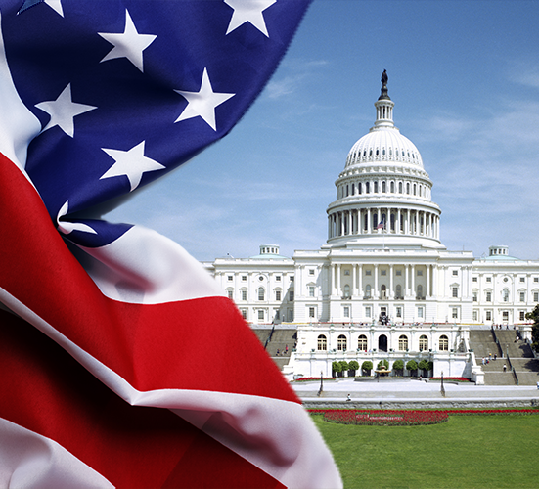
Thanks!

