Slide 1
The Remaking of China-EUrope Relations in the New Era of US-China Antagonism and Global Pandemic
LI Yuan, Institute of International Studies, Shandong University; and IN-EAST, University of Duisburg-Essen
&
HE Zhigao, Institute of European Studies, Chinese Academy of Social Sciences

Slide 2
Background
The change of United States’s attitude and strategic approach to China
From engagement to containment
Trade war, technologic war, decoupling
The change of EU’s attitude and strategic approach to China
The balance of challenges and opportunities shifted
Strengthen EU strategic sovereignty and reduce dependency on China
The COVID-19 pandemic has accelerated the US's pace to launch all-around attacks toward China, including forcing EUrope to take sides against China.
US‘s interference has influenced Europe-China relation

Slide 3
Question
How and Why EUrope’s policy toward China changed recently? How this affected China-Europe relation? As an external factor, how did the US affect China-Europe relation?
Will Europe assume an independent role, or will Europe join the US to contain China?

Slide 4
Changes in China-Europe Relations
Relations between the EU and China have developed fast since diplomatic ties were established 1975 (this year is 45th anniversary)
For a long time Europe sees China as opportunity and partner, as the EU and China share responsibility in the multilateral world, and addressing regional and global challenges.
In 2003 the EU announced that it had launched a ‘comprehensive strategic partnership’ with China.
In 2013 the EU and China signed “EU-China 2020 Strategic Agenda for Cooperation”
In 2014, in a joint statement, the EU and China reaffirmed their commitment to deepening their partnership for peace, growth, reform and civilization.

Slide 5
Changes in China-Europe Relations
Things gradually change after 2016, Trump election, Brexit
Europe caught in the middle of China-US conflict
More frictions and tensions emerge in
Trade
FDI
Global governance
Security
Value
2019 EU-China – A strategic outlook
The balance of challenges and opportunities presented by China has shifted
For the first time, define China as a systematic rival

Slide 6
Changes in China-Europe Relations
After the COVID-19 pandemic, besides mutual support and cooperation, frictions in some areas are also intensified.
At the beginning of the outbreak, some European media deliberately labeled the coronavirus with Chinese people.
Became more critical to China’s political system and measures to control the pandemic.
Calling for enhanced sovereignty for Europe and reduce economic dependency to China. “Strategic sovereignty for Europe”
More coordinated actions with the US against China. 5G etc.

Slide 7
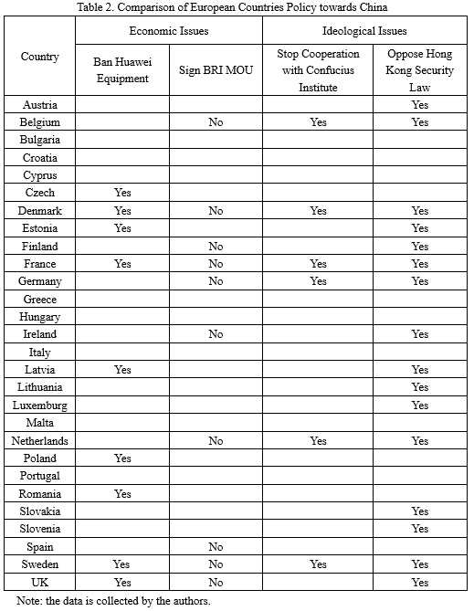
Variance of China policy between EU member states

Slide 8
Main factors behind the changes: External structural factors
Direct influence from the US
Changes in international order as a result of US policy

Slide 9
Main factors behind the changes: Internal behavioral factors
Economic interests
Although not caused by US, but have aligned interests with the US
Value
Influenced by the US
Rise of anti-globalization and populism sentiment
Influenced by the US

Slide 10
But EUrope is different from the US
Not a “Thucydides Trap” logic
No direct contention in regional and global security issues with China
Support multilateralism and want to prevent Cold war-style bipolar world order from forming.
Mutual benefit in economic cooperation with China.
Is Europe prepared to shoulder its historical responsibility?

