Slide 1
Factors for Change —The China-U.S.-Europe Triangle
Quansheng Zhao
American University
zhao@american.edu
Digital Conference
“China-US-Europe: Global Power Triangles
& the Remaking of the international Order”
October 23, 2020, Freie Universität Berlin

Slide 2



“A nation has no permanent enemies and no permanent friends, only permanent interests.” –Winston Churchill

Slide 3
Factors for Change
Residual Factors
5 Dynamics for Change
Nature of the Relationship
Perspectives from Washington, EU, & Beijing
Flashing Points in East Asia
Who is the Balancer?
Uncertain Directions of the Triangle

Slide 4
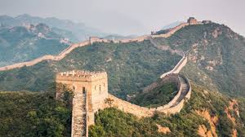
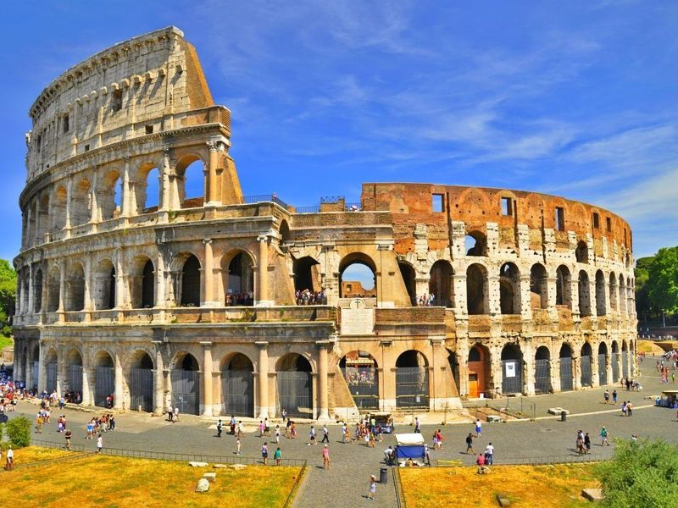
Residual Factors
History
Culture
Ideology

Slide 5
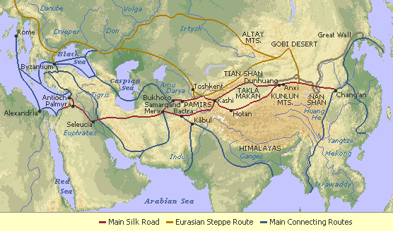
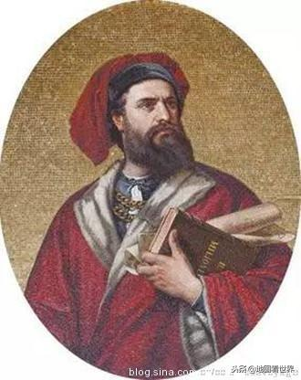
Historical Interactions Silk Road

Slide 6
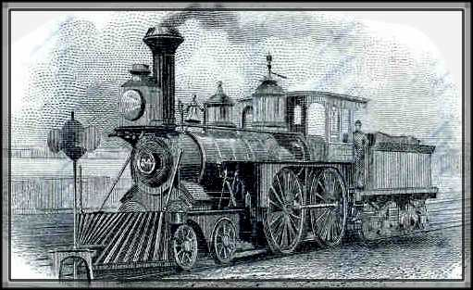
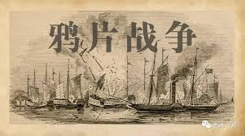
Europe’s Traditional Images
Ancient Civilization
Democracy
Industrialization
Imperialism and Colonialism

Slide 7
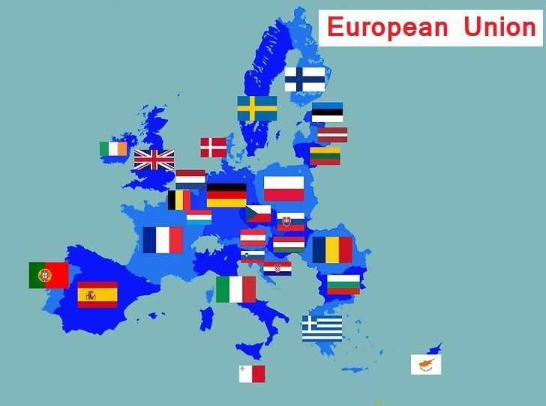
Value and Culture
Democracy and Human Rights
Rule of Law
Regional Integration
Cultural Pluralism
International Students

Slide 8
Five Dynamics for Change
Priority of National Interests
Power Distribution
Alliances
Diplomatic Opportunities
International-Domestic Linkage

Slide 9
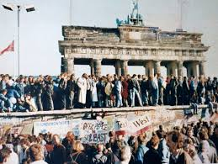
1. Priority of National Interest
China’s Modernization—”open & reform” improve relations with the US, Japan and Europe
EU: Post-cold war
Regional integration

Slide 10
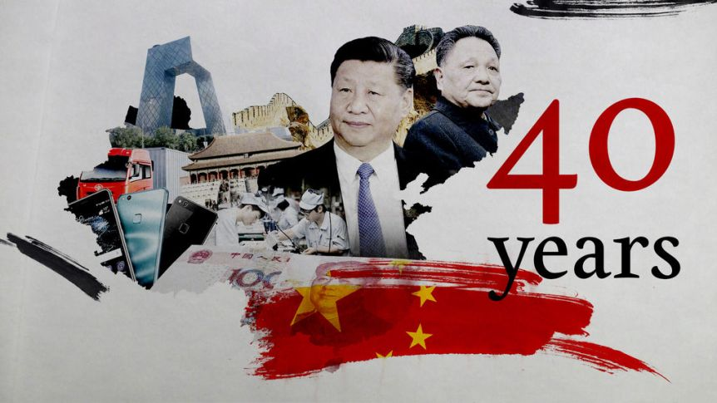
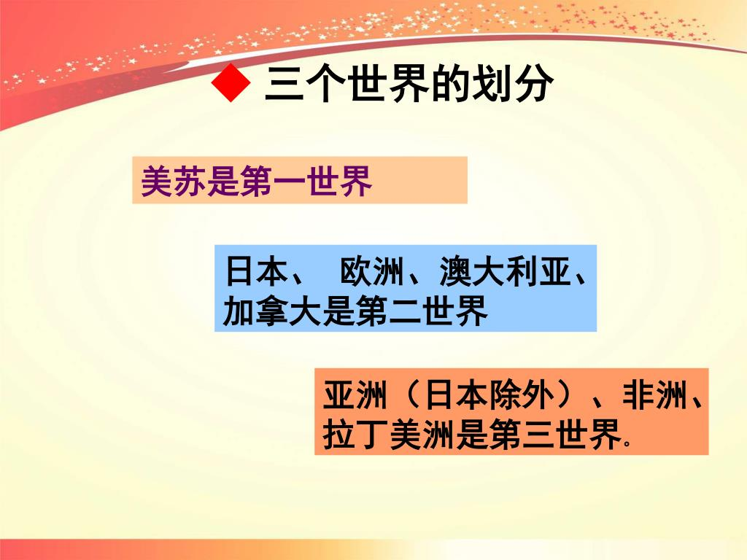
From Mao to Deng to Xi Europe Never an Enemy
Mao’s “Three World”
Europe was the 2nd World
Deng’s Open Policy:
Capital, Market, and Technology

Slide 11
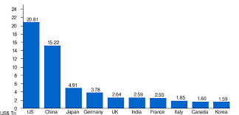
2. Power Distribution
China: became #2 economy in 2010
followed by Japan, Germany, UK, India, France, and Italy

Slide 12
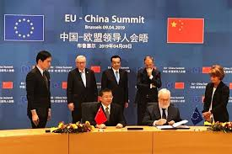
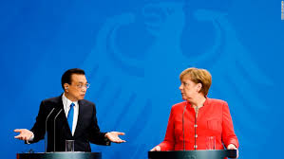
Cooperative vs Competitive
Mixed signals: Germany’s new campaign calling for diversification from China, with Merkel suggesting that businesses expand their Asian market.
EU-China Summit

Slide 13
3. Alliances
Cold War: Two Camps
Communism--China allied with Soviet Union
Capitalism—West Europe's alliance with U.S.
NATO

Slide 14

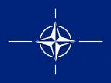
Global Strategic Pictures
Cold War and NATO
Post Cold War EU’s Role: An Independent Pole?

Slide 15
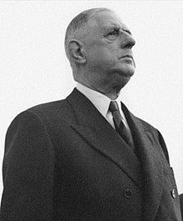
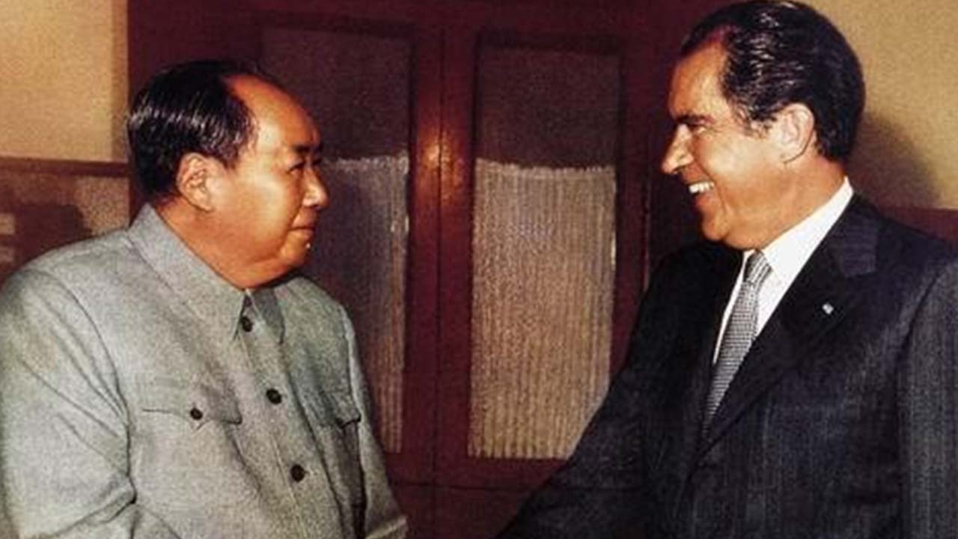
4. Diplomatic Maneuvers
Challenges and opportunities
Charles de Gaulle’s 1964 decision for diplomatic relations with China
Nixon/Kessinger 1972 visit to Beijing

Slide 16
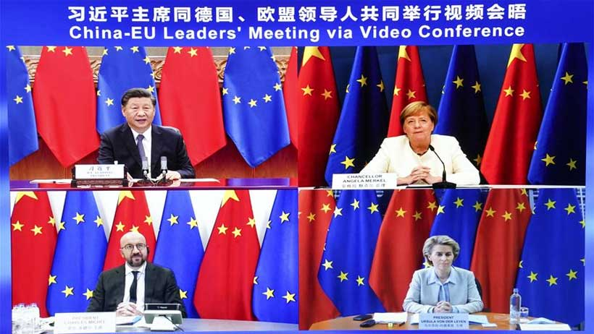
A Critical Juncture
The Rise of China and EU’s Economic Power
Mutually Beneficial , but….
Summit Meeting in a Critical Juncture (Sep 2020)

Slide 17
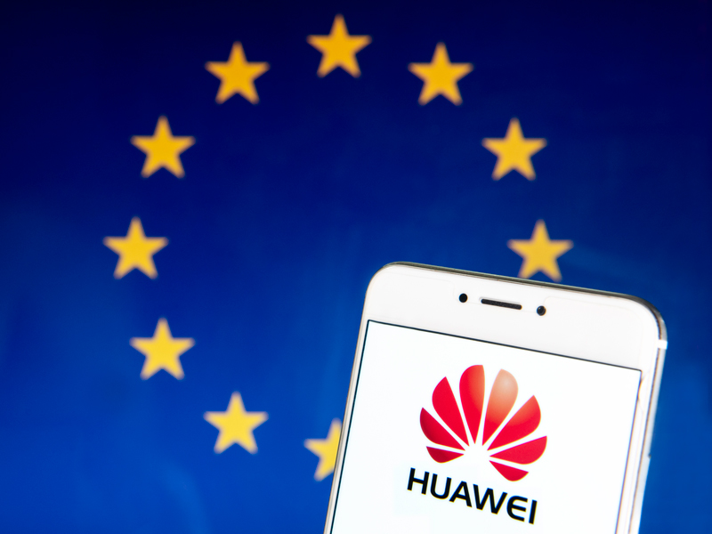
Diplomacy and Involvement: Confrontation vs. Engagement
Huawei & 5G
Human Rights
Hong Kong
North Korea and Six Party Talks
Climate Change

Slide 18
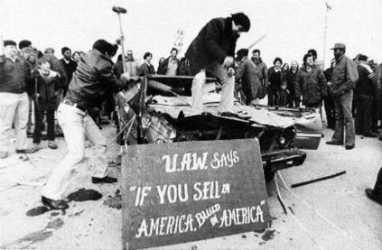
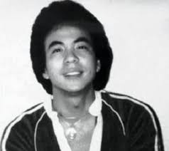

5. International-Domestic Linkages
U.S. in 1980s—“Japan Bashing” –largest economic rival
U.S. domestic debate: “China Threat”
EU changing perceptions about China
Murder of Vincent Chin

Slide 19
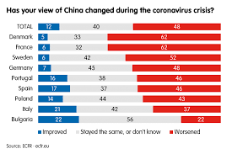
Europe’s Changing Perceptions of China How would it Translate into Foreign Policy?

Slide 20

Washington Perspectives
World Dominant Position: No One Can Challenge
From “Japan Bashing” to “China Threat”
Maintain the current international system
Power transition theory and “hedging strategy”
“Pivot to Asia”
Military Alliance
The U.S. role in China-EU relations
“Make America great again”

Slide 21
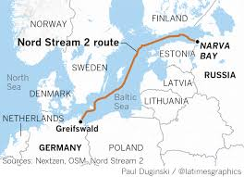
Trump’s EU Policy
Future of NATO?
EU not exempt from US tariffs
US withdraw troops from Germany
The Russia factor: Nord Stream 2 Route
Post-Trump Era?

Slide 22
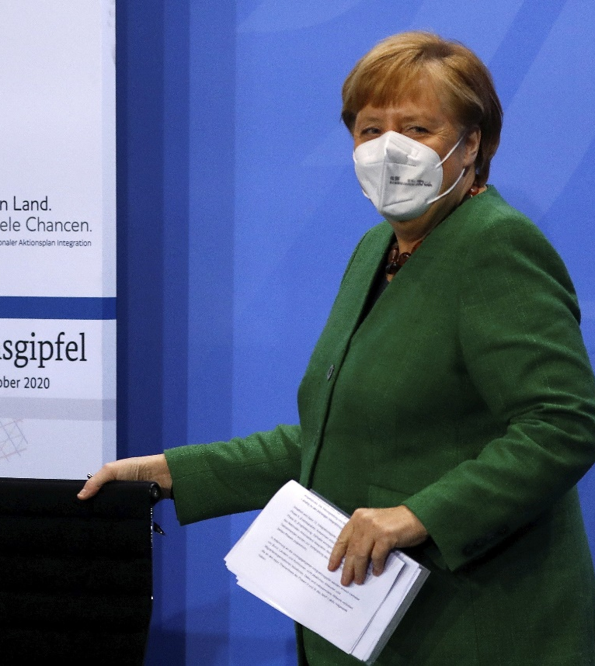
EU Perspectives
Security Alliance—NATO
Dependent, Independent, or Interdependent?
Balancing or Bandwagon?
Where is Germany Going?
EU’s role in US-China relations

Slide 23

Beijing Perspectives
“Tao guang yang hui” vs. “You suo zuo wei” (keep low profile vs. make contribution)
“Peaceful Rise” and “China Dream”
Power Transition and the “Thucydides Trap”?
EU is a balancer
Hard Power vs. Soft Power
Western Dominance of Discourse Power
China’s role in US-EU relations

Slide 24
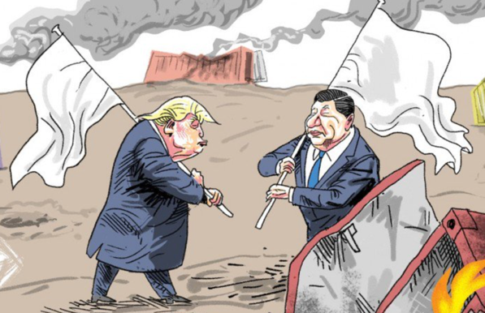
US and China: A New Cold War?
Battle Fields
Start from a Trade War
Science and Tech
Political and Ideology
Security and Military
McCarthyism
Rising Nationalism
Possible Cooperation?
North Korea
Climate Change (Biden?)
Notes:
US Stock market in October wiped out all the gains it made in 2018. Nearly $2 trillion lost, largely in technology stocks.

Slide 25
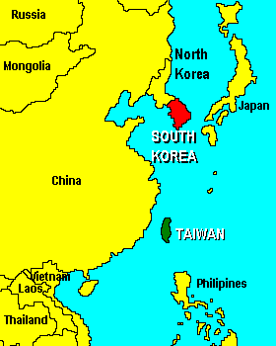
Flashing Points in East Asia “Four Seas”
Two Old Hot Spots:
Korean Peninsula
& Taiwan Strait
Two New Hot Spots：
Disputes：
East China Sea &
South China Sea

Slide 26
Great Powers Management
Co-management of Major Powers
Global: G7; G20?
Regional:
- NATO
- ASEAN+3
- SCO (China-Russia)
- China-EU summit
- Indo-Pacific: U.S., Japan, Australia, India

Slide 27
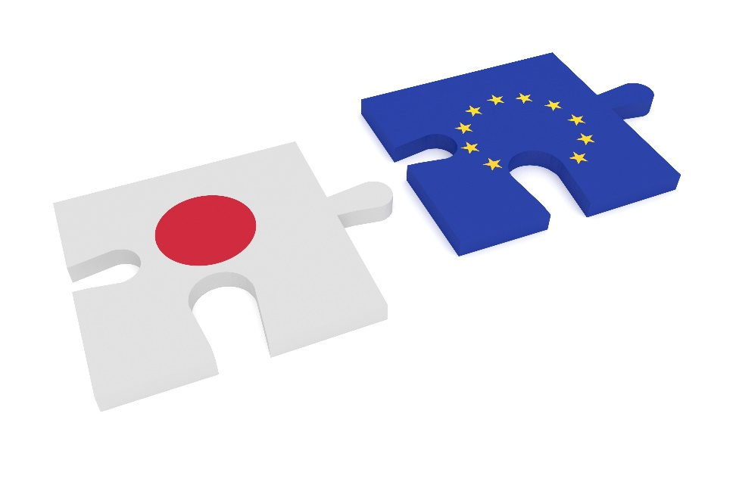
Who Are Balancers?
Trump: China and Russia are rivals
Only the U.S. would have the power and will to stop the “China dream”
EU and Japan are key balancers

Slide 28
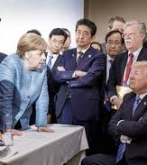
Uncertain Directions: EU Between US and China
EU is coordinating response to both China and U.S.
Ideology vs Economy: Huawei/5G
Post-Merkel Germany’s China Policy?

Slide 29
Conclusion: Factors for Change
Residual Factors
5 Dynamics for Change
Nature of the Relationship
Perspectives from Washington, EU, & Beijing
Flashing Points in East Asia
Who is the Balancer?
Uncertain Directions of the Triangle

