Slide 1
Thermal Effects on
Critical Flow Venturis
John Wright
NIST Fluid Metrology Group
16th FLOMEKO
September 25, 2013
Paris, France

Slide 2
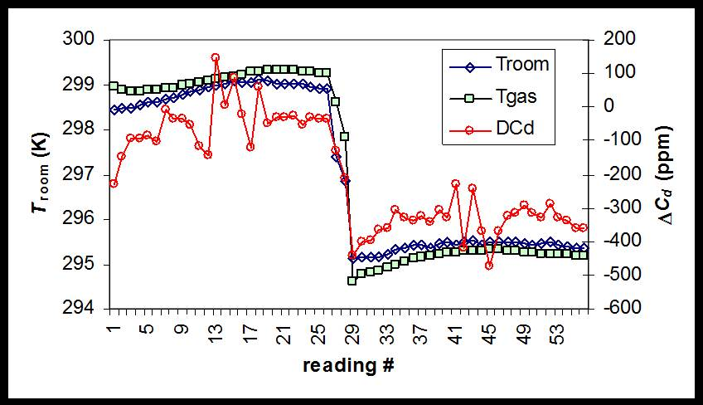
Motivation
In a comparison, environmental T sensitivity looks like lab-to-lab differences
~ 50 ppm / K
If Lab A tests at room T = 23 ºC
and Lab B tests at Room T = 28 ºC?
we can expect a ΔC_{d}
in a 0.4 mm CFV of 0.025%
We work at 23.5 ± 1 ºC, but what about our customers?

Slide 3
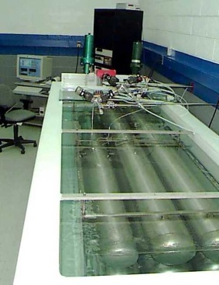
Sources of T Sensitivity
4) Sensitivity of reference sensors to room T, e.g. mass flow, pressure
Room T = 297.3 ± 0.5 K
34 and 677 L PVTt in T controlled water bath at 296.7 K
3) Thermal expansion of the throat area
2α = 34 x 10⁻⁶ / K, for SS and Cu-Te alloy 145
Significant for large CFVs, less so for small CFVs
d = 30 mm, Jones, Material Temperature Profiles in a Critical Flow Nozzle, ASME, 1983
d = 25 mm, Caron, Kegel, and Britton, 1995, 1996
2) Thermal boundary layer effects: heat transfer from CFV body to gas reduces gas density and mass flux at the CFV throat
1) Temperature “sampling errors” (spatial non-uniformity, stem conduction, time response)
Goal: quantify and correct temperature sensitivity

Slide 4
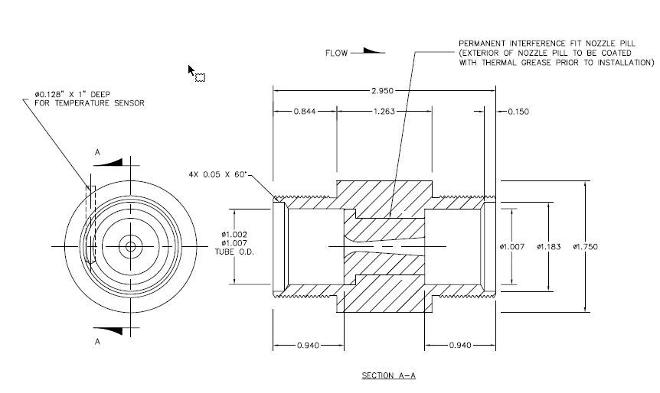
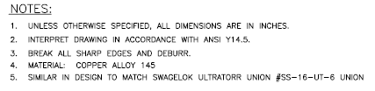
Copper (Cu) CFV Design
Four CFV d’s:
3.15, 1.09, 0.648, 0.356 mm

Slide 5
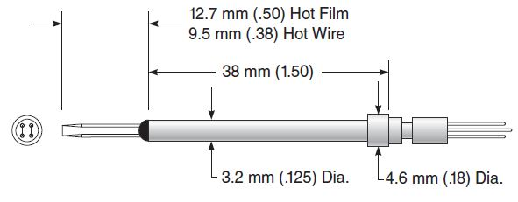
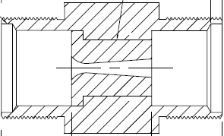

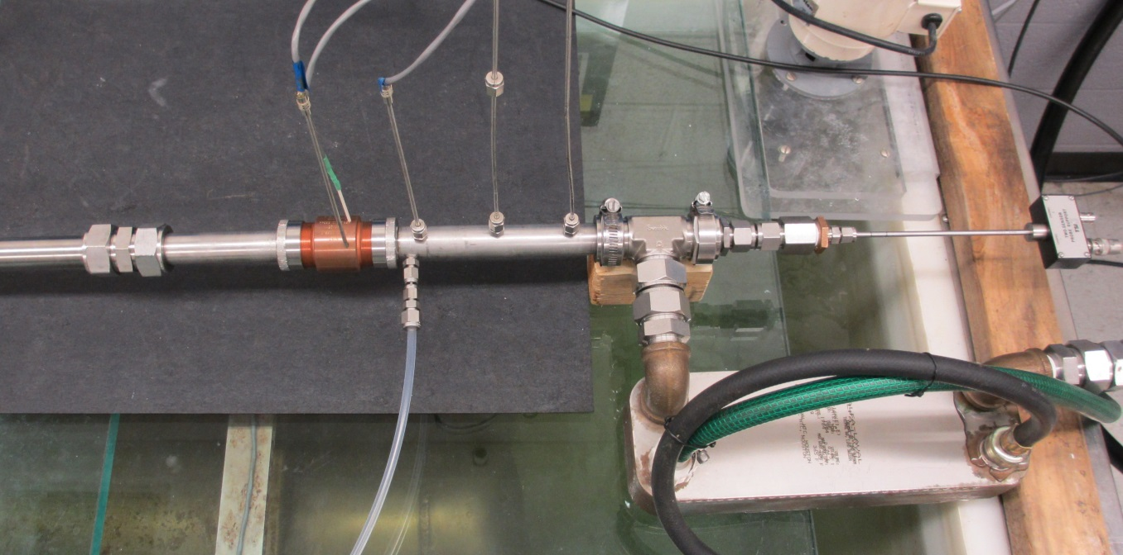
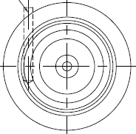
Experimental Arrangement #1
(to assess T sampling for typical (ISO/ASME) set up)
T_{CFV} _{body}
T_{up3}
T_{up2}
T_{up1}
T_{z} (“hot wire” T sensor)
Ceramic pipe liner
Cu CFV
Water pump
Heater controller RTD
Bead thermister (T_{CFV} _{body})
Water to gas heat exchanger

Slide 6
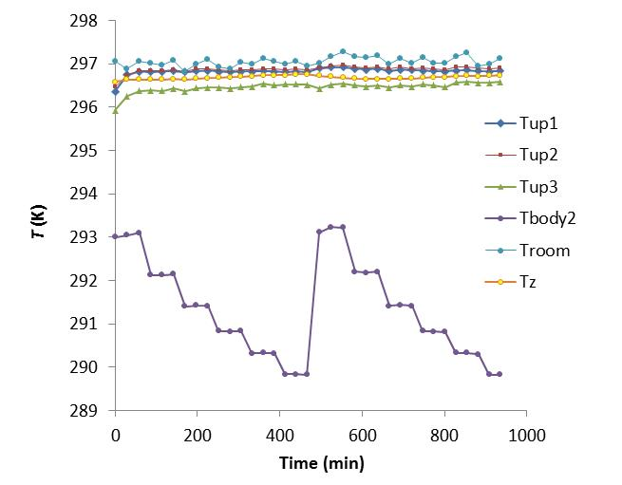
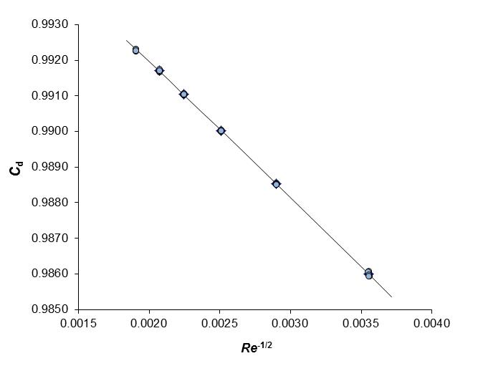
C_{d} Measurements
200, 300, 400, 500, 600, and 700 kPa
3 PVTt collections at each pressure
On 2 occasions, average of 6 points
U(C_{d}) = 0.06 %

Slide 7

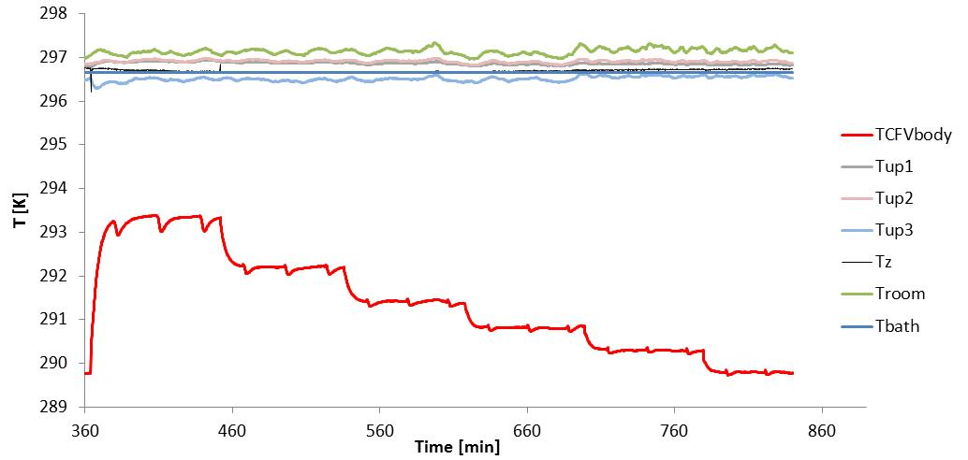
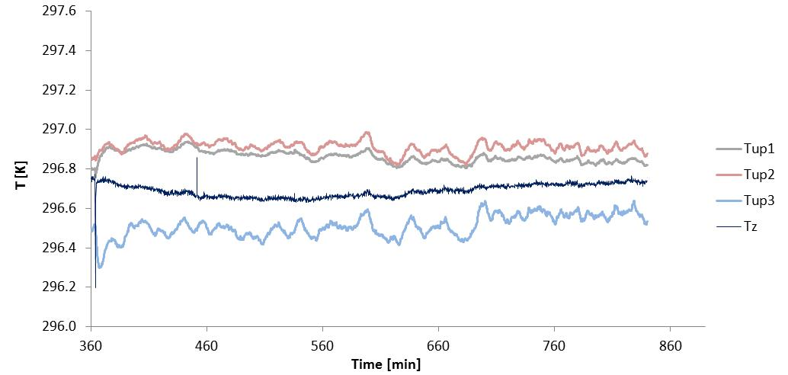
Spatial Temperature Variations (d = 3.15 mm, no CFV heating)
T_{CFV} _{body}
T_{up3}
T_{up2}
T_{up1}
T_{z}

Slide 8
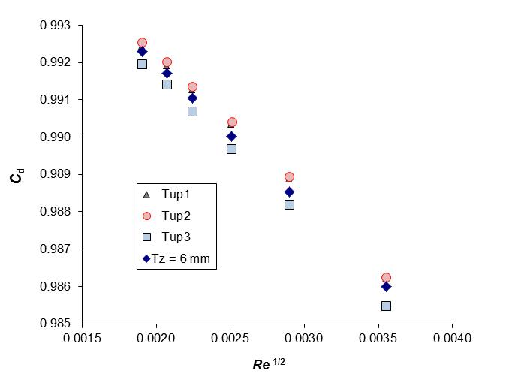
d = 3.15 mm, no CFV heating
T_{CFV} _{body}
T_{up3}
T_{up2}
T_{up1}
T_{z}
0.05 %
T_{up3} is cold due to conduction from CFV body through approach pipe wall

Slide 9
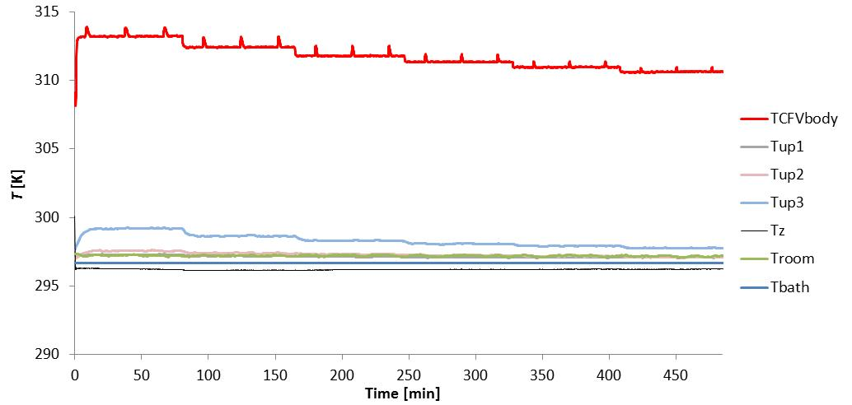
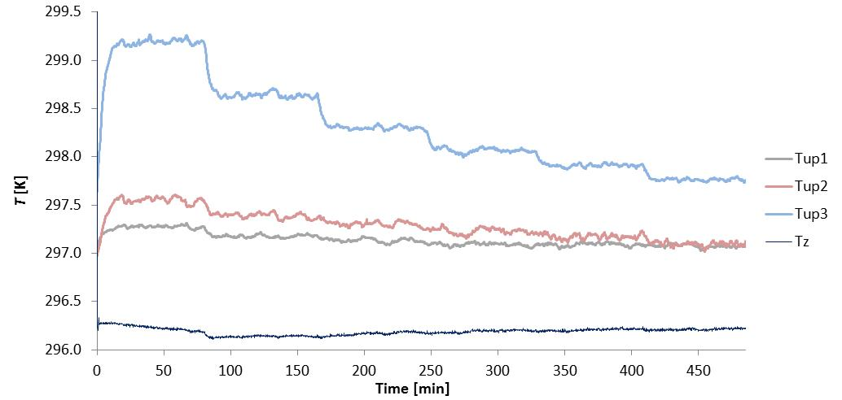
d = 3.15 mm, T_{CFV body} = 313 K
Add a PID controlled heater to CFV: 298, 303, 308, 313 K
T_{CFV} _{body}
T_{up3}
T_{up2}
T_{up1}
T_{z}

Slide 10
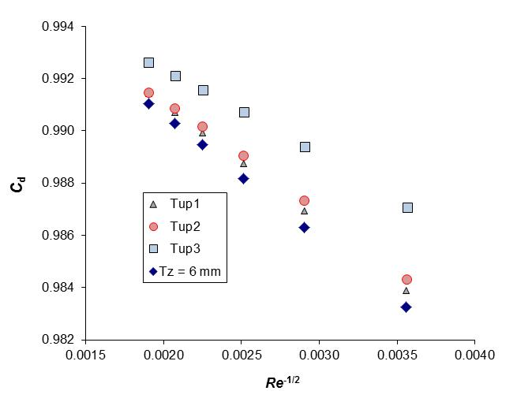
d = 3.15 mm, T_{CFV body} = 313 K
T_{CFV} _{body}
T_{up3}
T_{up2}
T_{up1}
T_{z}
0.39 %
T_{up3} is hot due to conduction from CFV body through approach pipe wall

Slide 11
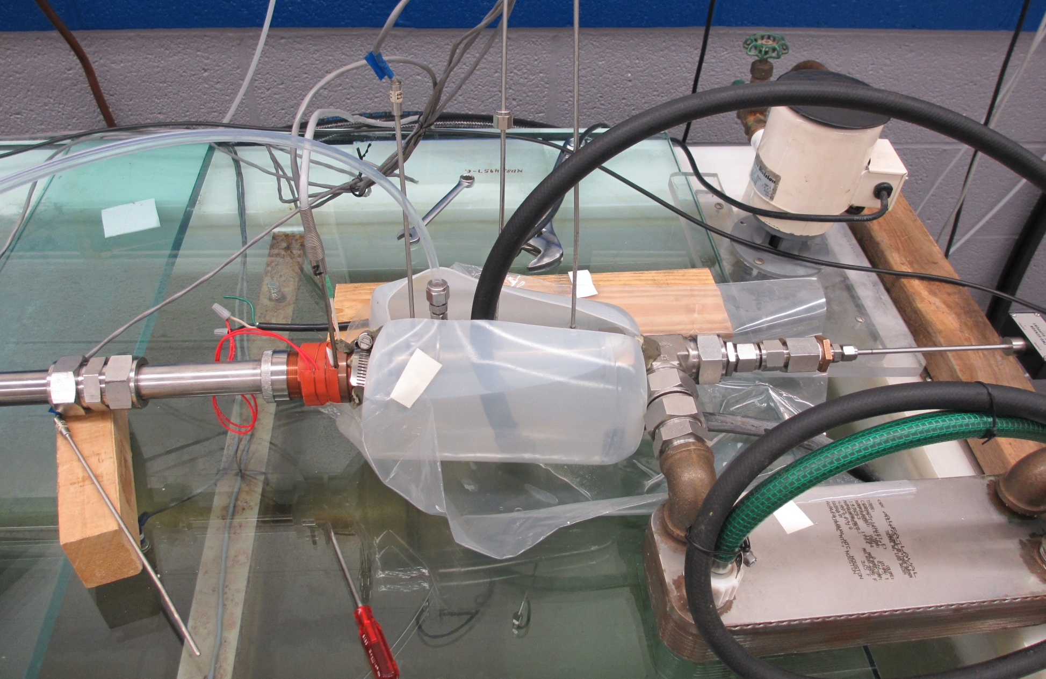
Experimental Arrangement #2
(to minimize T sampling uncertainties)
Water pump
Optional heater
Water to gas heat exchanger
Optional room T water jacket

Slide 12
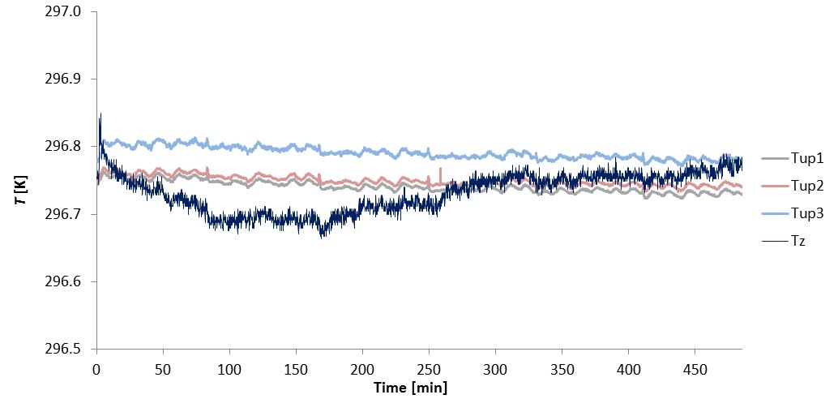
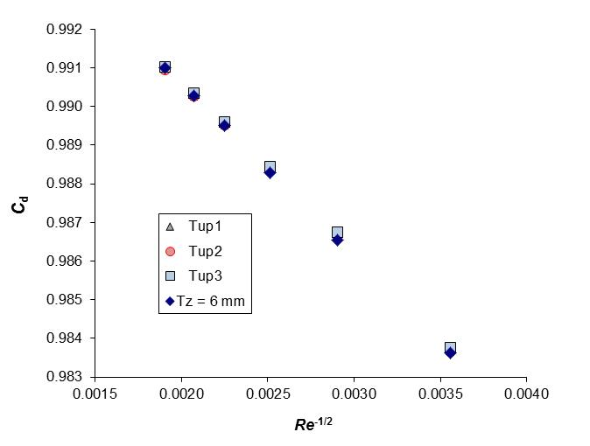
d = 3.15 mm, T_{CFV body} = 313 K
T_{CFV} _{body}
T_{up3}
T_{up2}
T_{up1}
T_{z}
Add a 297 K water bath to the approach pipe
0.01 %
All 4 T sensors give the same C_{d} values within 0.01 %

Slide 13
Numerous Heat Transfer Mechanisms
T sensor
Inlet gas
Internal flow
CFV body
Approach pipe wall
Room
Measured T₀ is subject to sampling errors due to heat transfer within the flow, CFV body, and approach pipe walls

Slide 14
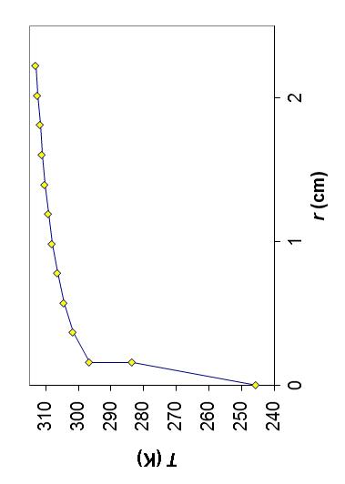
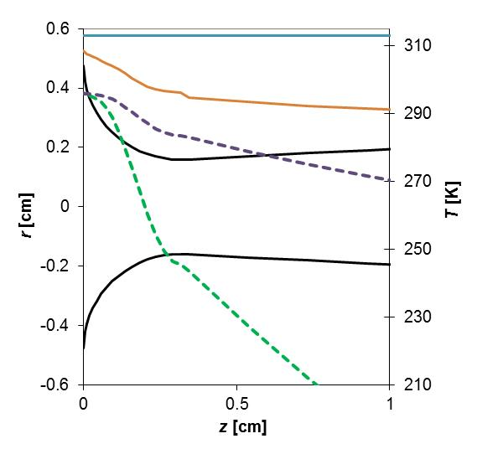
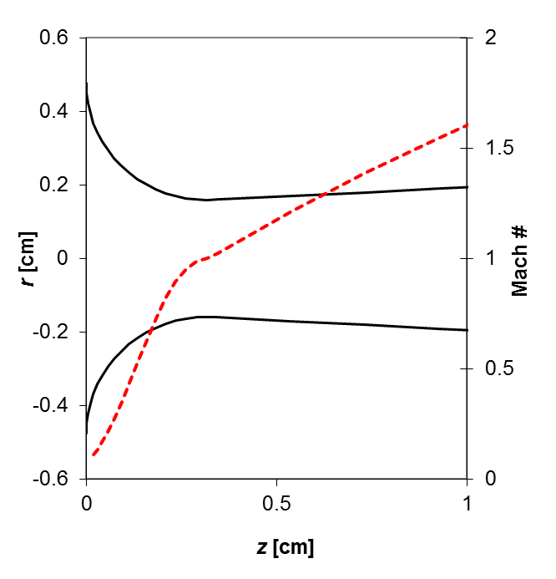
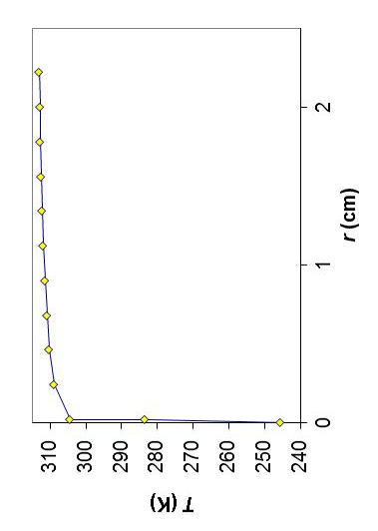
What is the temperature distribution in the gas and CFV body?
Assume 1-D, isentropic, adiabatic flow through a ISO toroidal copper CFV, 2.2 cm body radius, Bartz 1965 convective heat transfer coefficient, no axial direction heat transfer…
d = 3.15 mm
T_{CFV} _{ext}
T_{CFV} _{int}
T_{adiabatic wall}
d = 0.36 mm
T_{core}

Slide 15
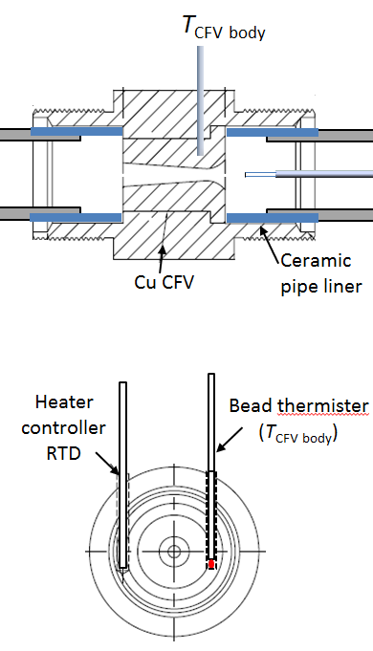
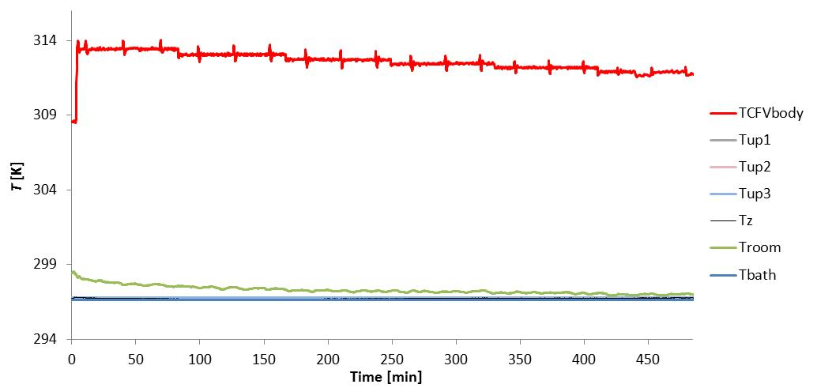
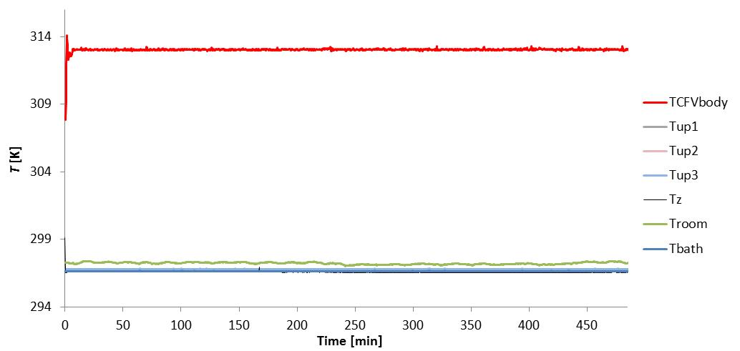
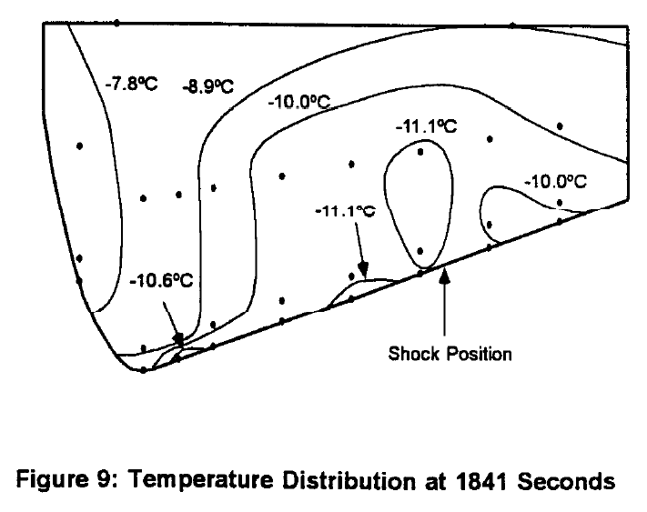
T Distribution in CFV Body
By using high thermal conductivity CFV material, T_{CFV body} is close to inner wall T
(Note that low thermal conductivity material is desirable for non-research applications!)
Material | k
 | [W/(cm K)]
Cu | 3.8
SS | 0.16
Macor | 0.0146
Kegel and Caron, ASME Fluids Engineering Summer Meeting, San Diego, California, USA, 1996.

Slide 16
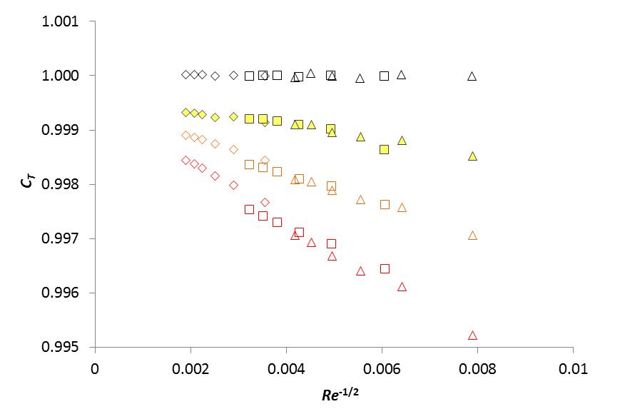
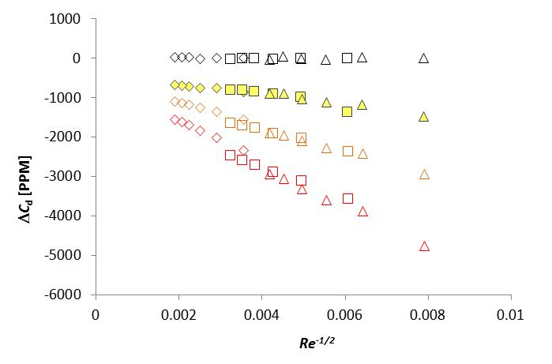
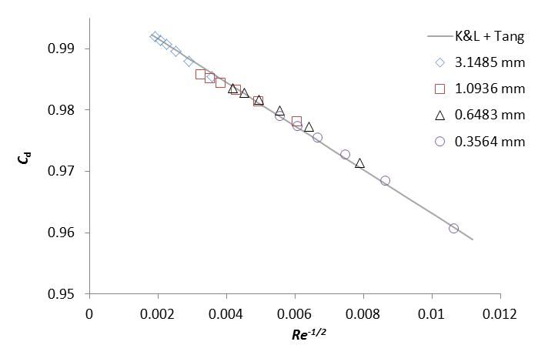
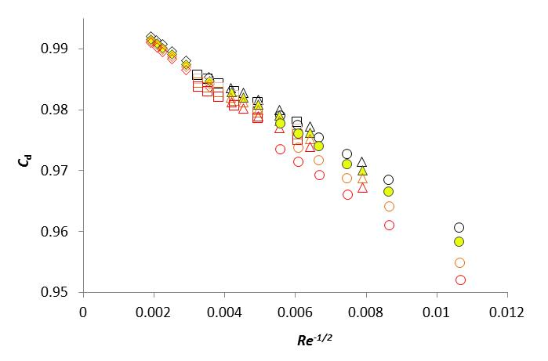
C_{T} Measurements
Four Cu CFVs: d = 3.15, 1.09, 0.65, and 0.36 mm
Use analytical C_{d} values and T_{CFV body}= 298 K data to determine d
PID control of T_{CFV body} = 298, 303, 308, and 313 K
Apply 2αΔT thermal expansion corrections (T_{ref} = 298 K) and plot differences in C_{d} relative to values at 298 K
Assume C_{T} = 1 - ΔC_{d} (because other known effects have been corrected)
298 K
298 K
303 K
303 K
308 K
308 K
313 K
313 K

Slide 17
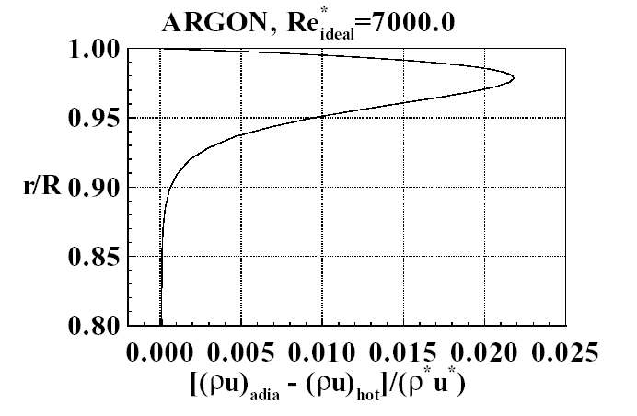
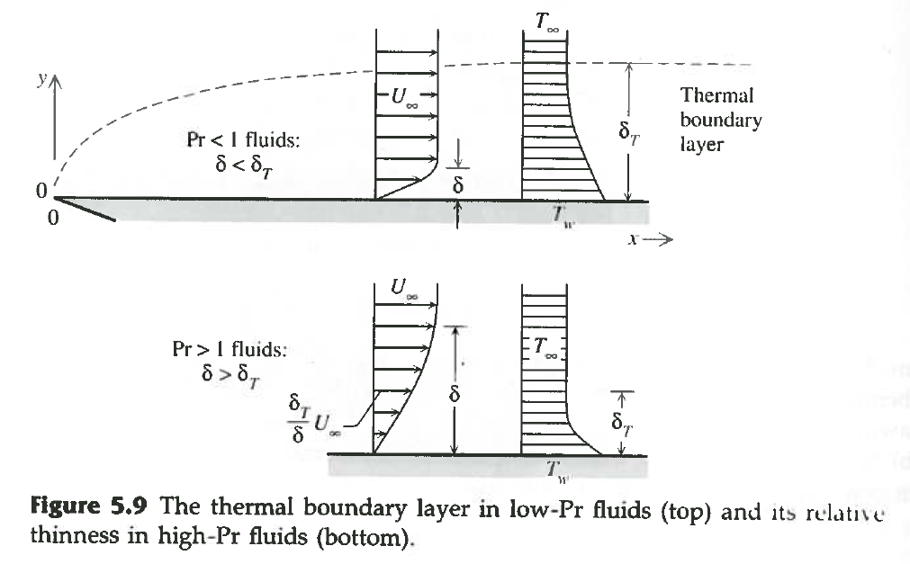
There is a velocity boundary layer AND a thermal boundary layer
CFV theoretical mass flow equation assumes adiabatic wall (no heat transfer from CFV body to gas)
In reality, a thermal boundary layer is present
The warmer, lower density layer near wall leads to lower flow than adiabatic assumption
Bejan, Heat Transfer, 1993
Johnson, A. N., 2000

Slide 18
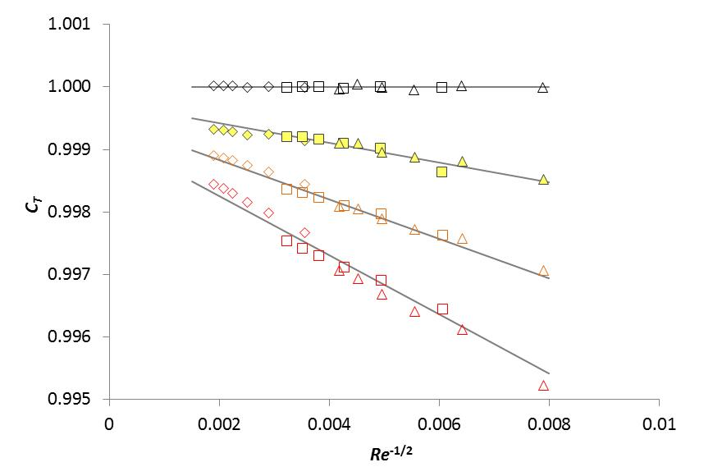
A Correction for the Laminar Thermal Boundary Layer
Choose a reference T_{CFV body} (298 K)
Assume C_{T} = 1 - ΔC_{d} (because other known effects have been corrected)
As for C_{vbl}, C_{T} scales with Re^{-1/2}
C_{T} is proportional to the density change in the thermal boundary layer relative to some reference condition, i.e. proportional to (T_{ref} -T_{CFV body}) / T_{ref}
298 K
303 K
308 K
K = empirical constant
313 K

Slide 19
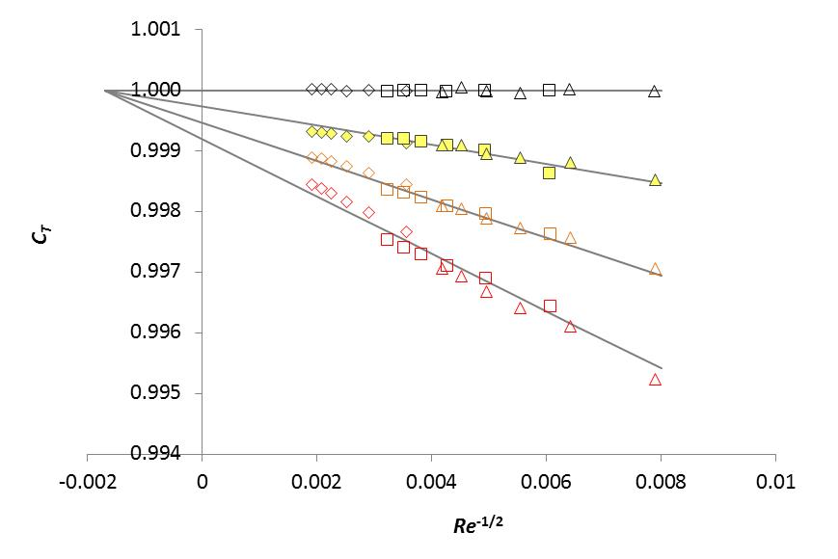
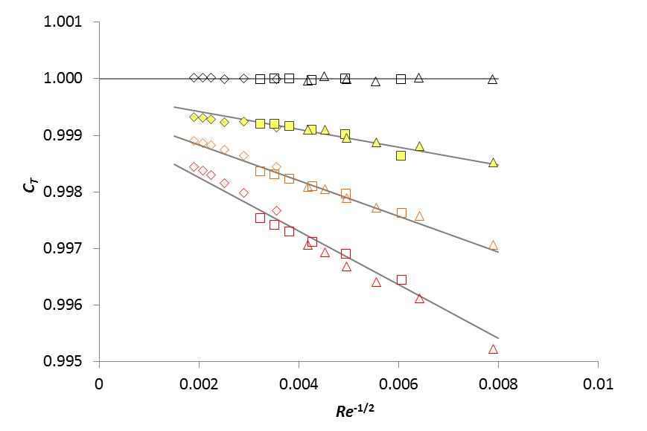
A Correction for the Laminar Thermal Boundary Layer
Laminar to turbulent boundary layer transition leads to a Reynolds number offset (Re₀)

Slide 20
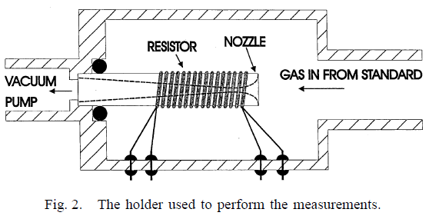
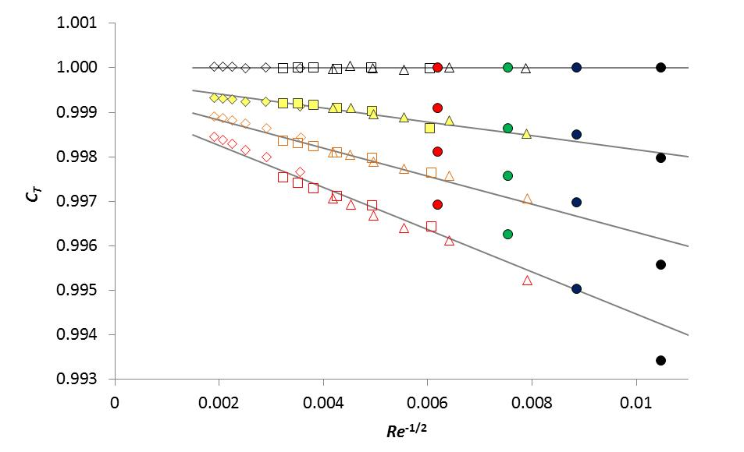
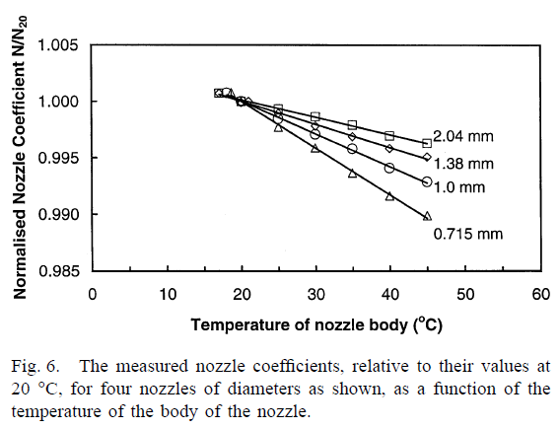
In prior studies:
Bignell, N. and Choi, Y. M., Thermal Effects in Small Sonic Nozzles, Flow Meas. Instrum., 13, pp. 17 – 22, 2002
2.04 mm
1.38 mm
1.0 mm
0.715 mm

Slide 21
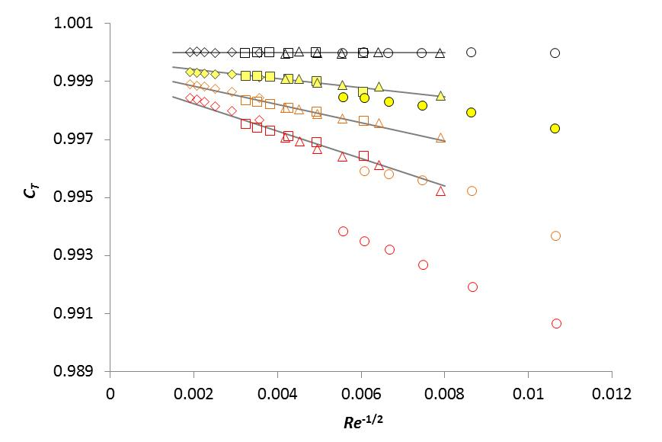
0.36 mm CFV, T Sampling?

Slide 22
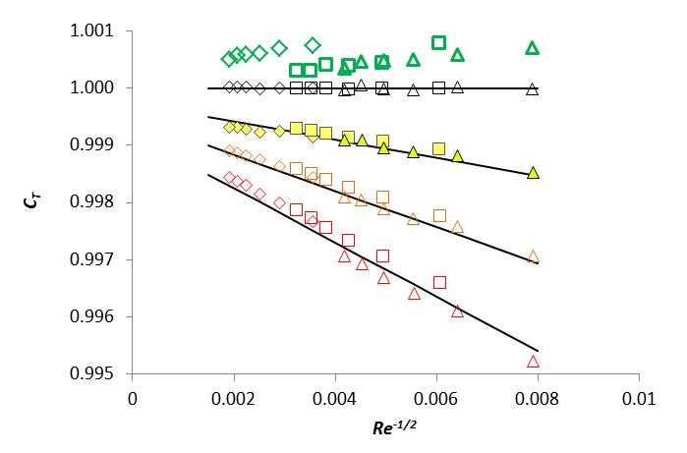
Because of CFV body cooling, when we perform a “Room T” calibration, we are following an arc in the C_{T} plane…
288 K ?
293 K ?
298 K
303 K
308 K
313 K

Slide 23
Conclusions
In small CFVs (< 10 mm?), temperature sampling errors and thermal boundary layers lead to significant temperature sensitivity (50 to 300 ppm/K)
Making thermal expansion corrections in small CFVs makes the temperature sensitivity worse!
There are complex heat transfer mechanisms and significant temperature gradients in CFV installations
Better designs of approach pipe, T sensors, sensor placement, and CFV materials will reduce CFV calibration reproducibility and sensitivity to room T
A simple physical model for the thermal boundary layer matches experimental C_{T} values, i.e. corrections are possible

