Slide 1
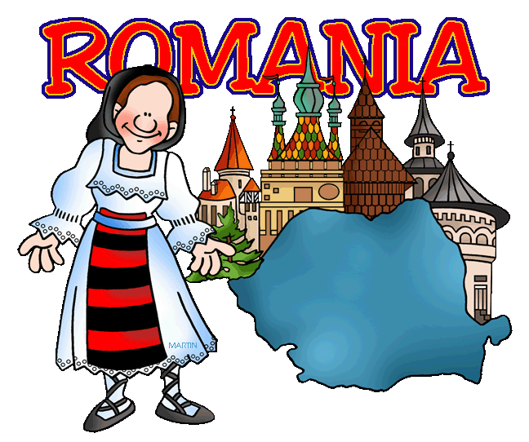
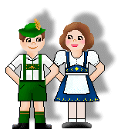
Understanding of Democracy
Learning Session I:
Theoretical Foundation
- Attitudes - Travelling of Concepts
- National Sources - Political Socialisation
- Understandings - Political Support
Presentations with examples and discussions
Learning Session II:
Germans get to know Romania
Excursion
Learning Session III:
Empirical Research
- Modernisation - International Surveys
- Diversity - Types of Democracy
- Understanding of Democracy in Eastern Europe
Learning Session IV:
Romanians get to know Germany
Excursion
Learning Session V:
Supervised Group Work on Research Questions related to the Understanding of Democracy
Finding Reasons for Different Understandings of Democracy
4 Days à 6 Hours
Presentation + Discussion
Research Question → Appropriate Theory → Appropriate Research Method → Data → Data Analyses → Findings → Interpretation

