Slide 1



Antisemitism & Hate on Social Media

Slide 2
Agenda
Tone Setting: How do we want to communicate?
Experiences with Antisemitism and Hate on Social Media
Social Media Literacy
ShoutOut Online Game
Discussion
Final Reflection

Slide 3
Tone Setting
  Ask questions and articulate thoughts instead of opinions:
❓
  What do we need as a group to hold a challenging discussion?
  What responsibilities do we have?
  We are responsible for what we say and for everyone else in the room!
I'd like to understand …
🤔
I wonder …
I‘ve noticed that …
💡
I'm not sure about …

Slide 4
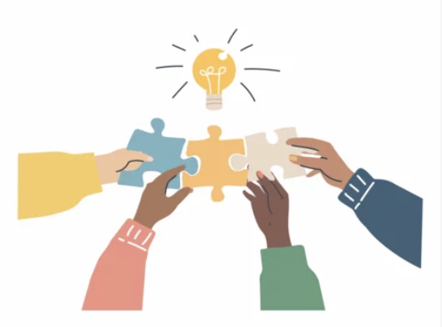
Small-Group Activity
Discuss this in your group:
What experiences have you had with hate and anti-Semitism on social media? What do you see?
2. How do you deal with this? How does it make you feel?
Collect your results…

Slide 5
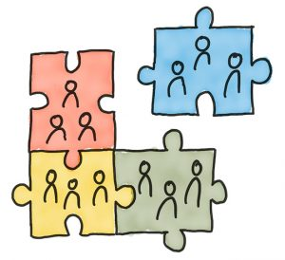
Whole-Class Discussion
Wir sammeln Eure Erfahrungen ….
Welche Erfahrungen und Umgangsformen mit Antisemitismus und Hass in Sozialen Medien wurden in Euren Gruppen deutlich?
2. Welche Gemeinsamkeiten und Unterschiede zeigen sich zwischen den Gruppen?

Slide 6

BREAK
🫠

Slide 7
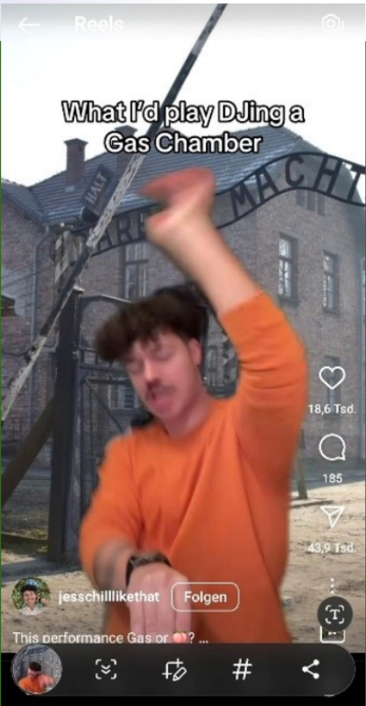
Small-Group Activity
1. Discuss in your group:
A. How does this post make you feel—and why?
B. What elements confuse, irritate, or disturb you?
C. Why do you think it is so succesful?
2. Answer the following questions:
Content Level: What is being referenced here, and how is it being used?
Emotional Level: What emotional reaction does it provoke?
Technology Level: What part do the Likes, Comments and Shares play?

Slide 8
Whole-Group Discussion
We're collecting your experiences ….
What did you learn from the post, its impact on you, and the significance of likes, shares, and comments?
2. What does social media literacy mean to you?

Slide 9
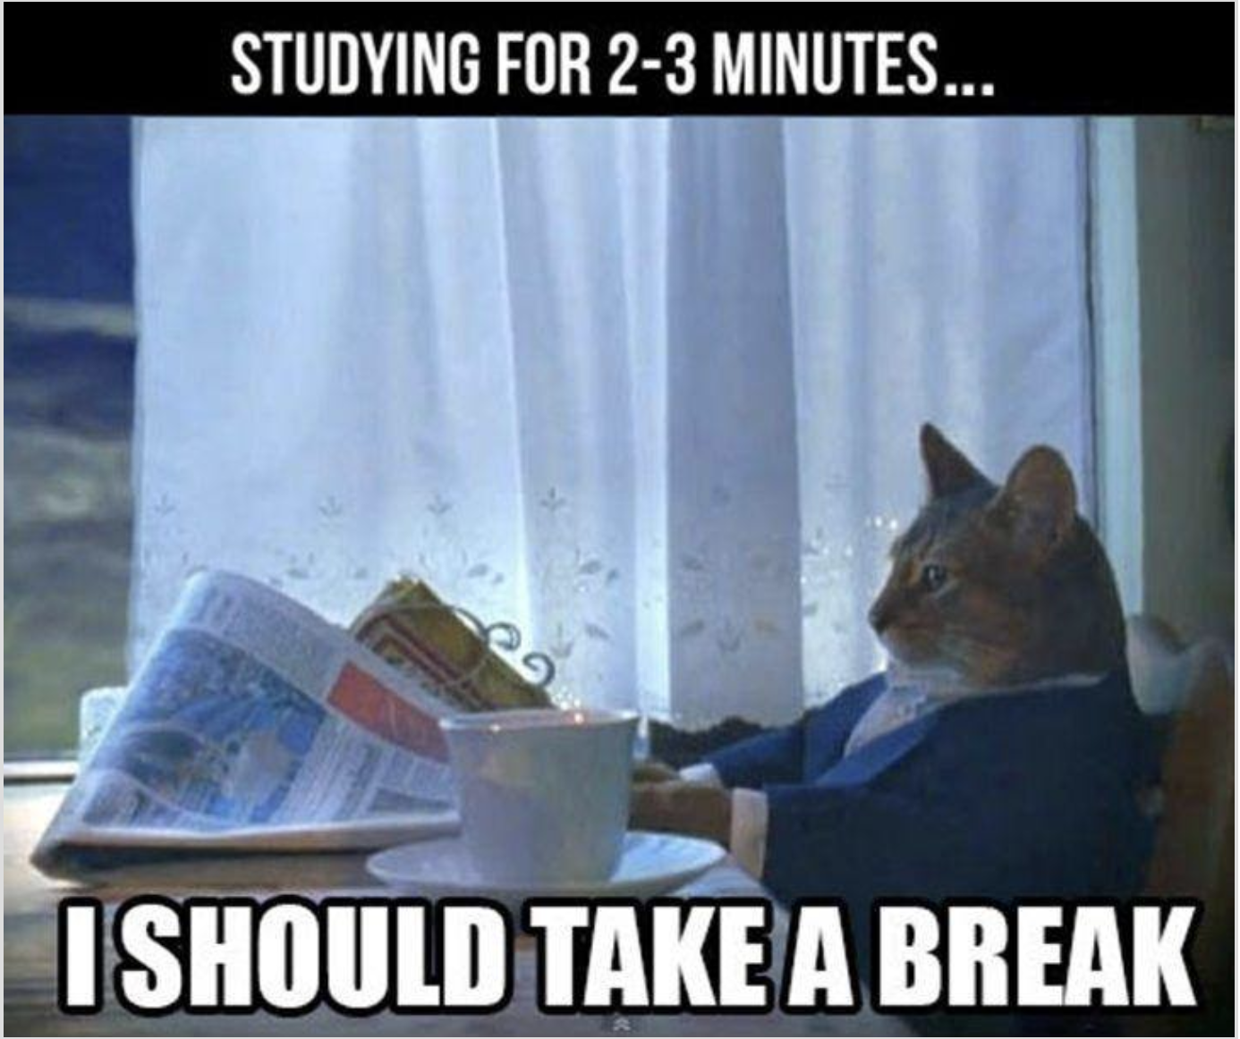
Pause
Break 🫠🧠☕

Slide 10

Using symbols of the Holocaust to mock it /
Holocaust distortion
Using Nazi symbols as entertainment
Link to the digital learning environment
ShoutOut DigiBoard
lots of likes
lots of comments
lots of shares
Follow the activities on the Digiboard: The participants play the game, and after the game, they discuss selected posts.
All game content is available as images on the Digiboard.

Slide 11
Final Reflection
Using symbols of the Holocaust to mock it /
Holocaust distortion
Using Nazi symbols as entertainment
What was new for you today?
What did you find particularly interesting or relevant?
What do you take with you for your daily life?
lots of likes
lots of comments
lots of shares

